Slide 1
I would have wanted to work, but deep down I’m enormously lazy. I like living, breathing, better than working. I don’t think that the work I’ve done can have any social importance whatsoever in the future. Therefore, if you wish, my art would be that of living: each second, each breath is a work which is inscribed nowhere, which is neither visual nor cerebral. It’s a sort of constant euphoria. Marcel Duchamp, 1971

Slide 2
We still don’t know how much less ‘nothing’ can be. Lucy Lippard & John Chandler1968

Slide 3
What is TEACHER AS CONCPTUAL ARTIST? TEACHER AS CONCEPTUAL ARTIST is not a formula. Thinking through conceptual art practices simply engenders the big question: What permissions does conceptual art open up for a teaching practice? Conceptual art, although frequently housed in the visual arts, is first and foremost non-media specific. It’s a means to experiment with one’s traversal through the world and actively think it differently. Whatever media one works in--- be it dance, theatre, music, or visual arts (or even non-art creative practice)—should be specific to the ideas that are being pursued.

Slide 4
What permissions does conceptual art discourse open up for our practice?

Slide 5
WE CAN THINK OF OUR INSTITUTION(S) AS MATERIAL
WE CAN GATHER ENERGY VIA ACCUMULATION
WE CAN USE CLOSENESS
WE RELY AND VALUE CO-CONSTRUCTION
WE UNDERSTAND INVISIBILITY IS A POWERFUL WAY OF BEING IN A WORLD THAT ALWAYS WANTS TO SEE YOU
WE WRITE AND DEPLOY OUR OWN NARRATIVES

Slide 6
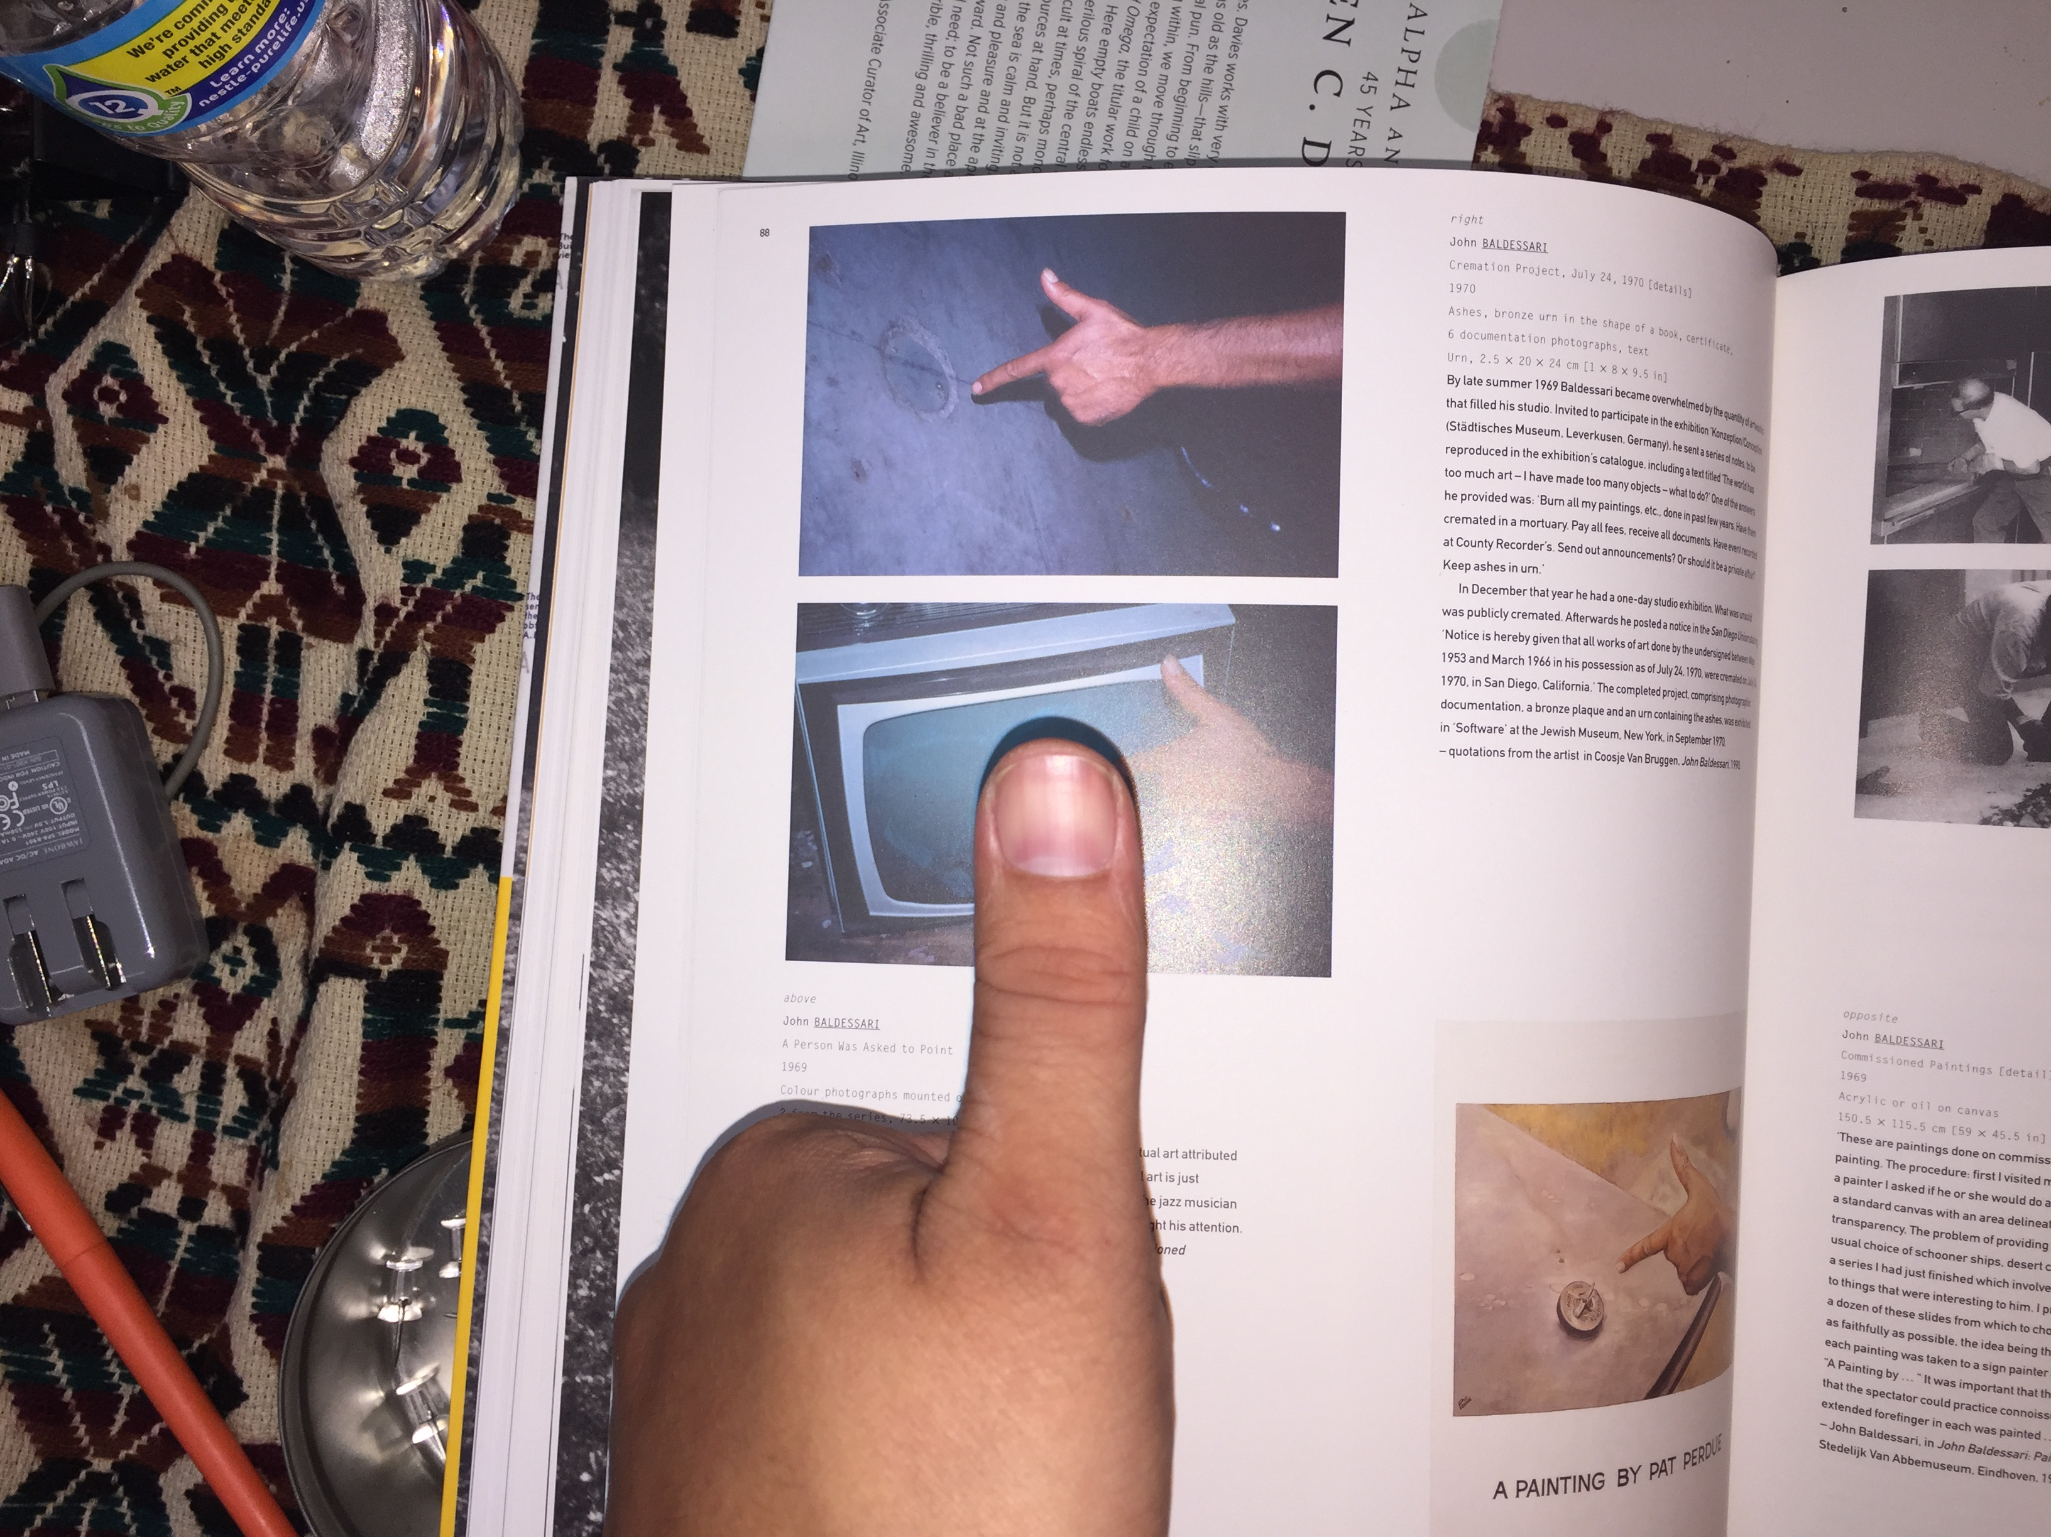
Mode 1: Institution as Material

Slide 7
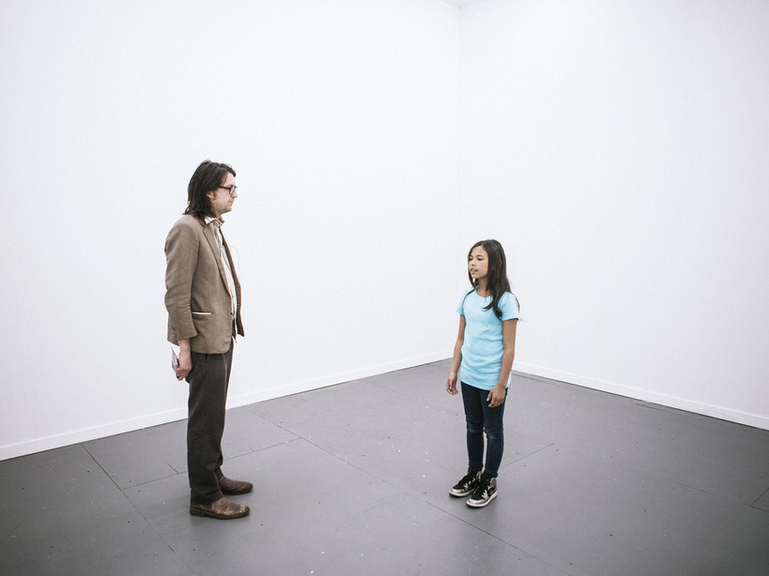
TINO SEHGAL

Slide 8
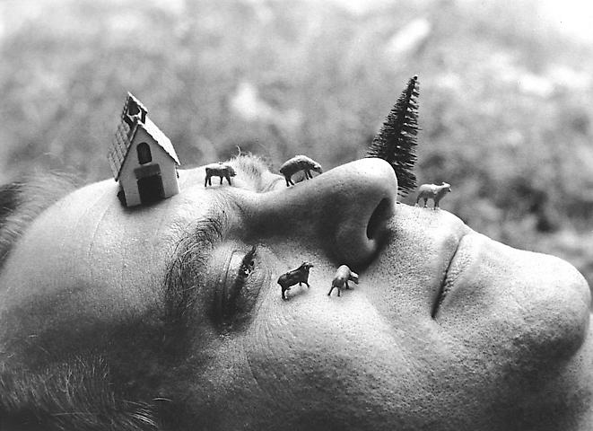
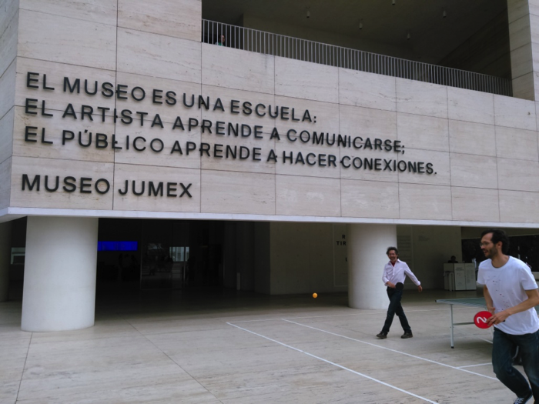
LUIS CAMNITZER

Slide 9
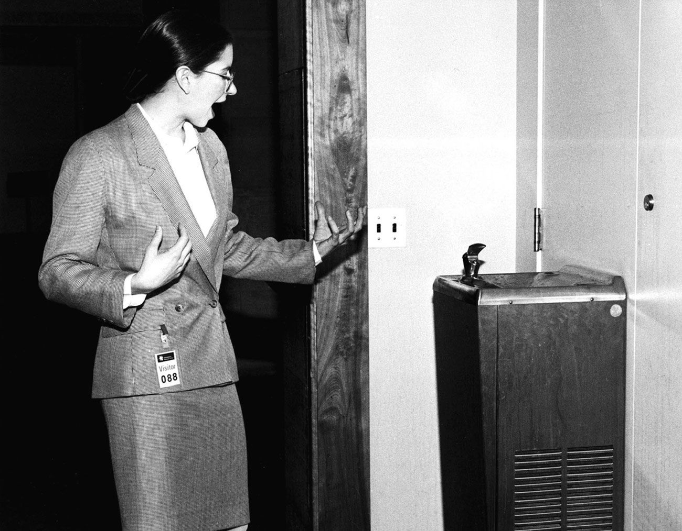
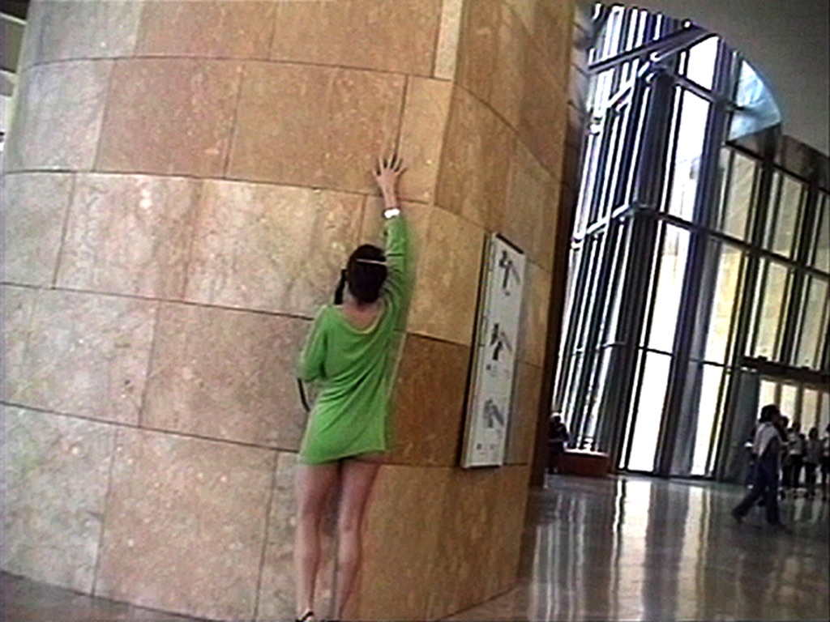
ANDREA FRASER

Slide 10
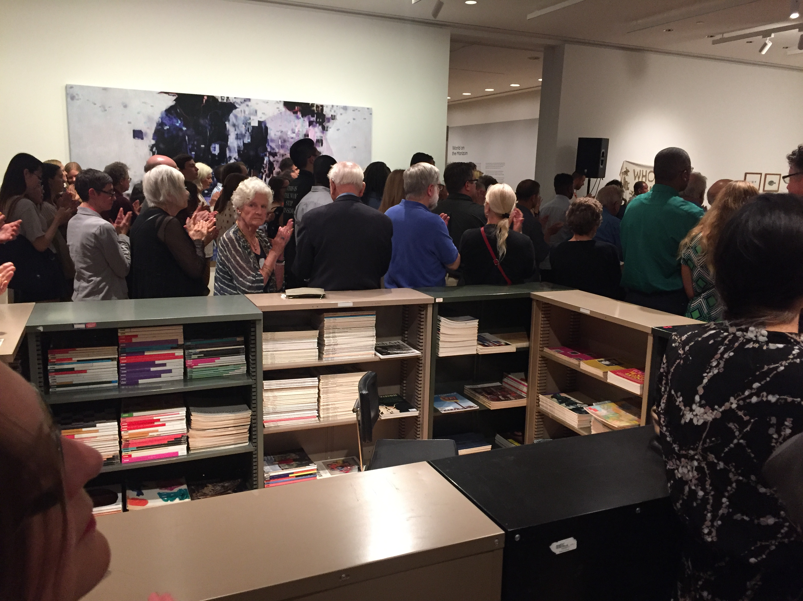
Mode 2: Energy via Accumulation

Slide 11
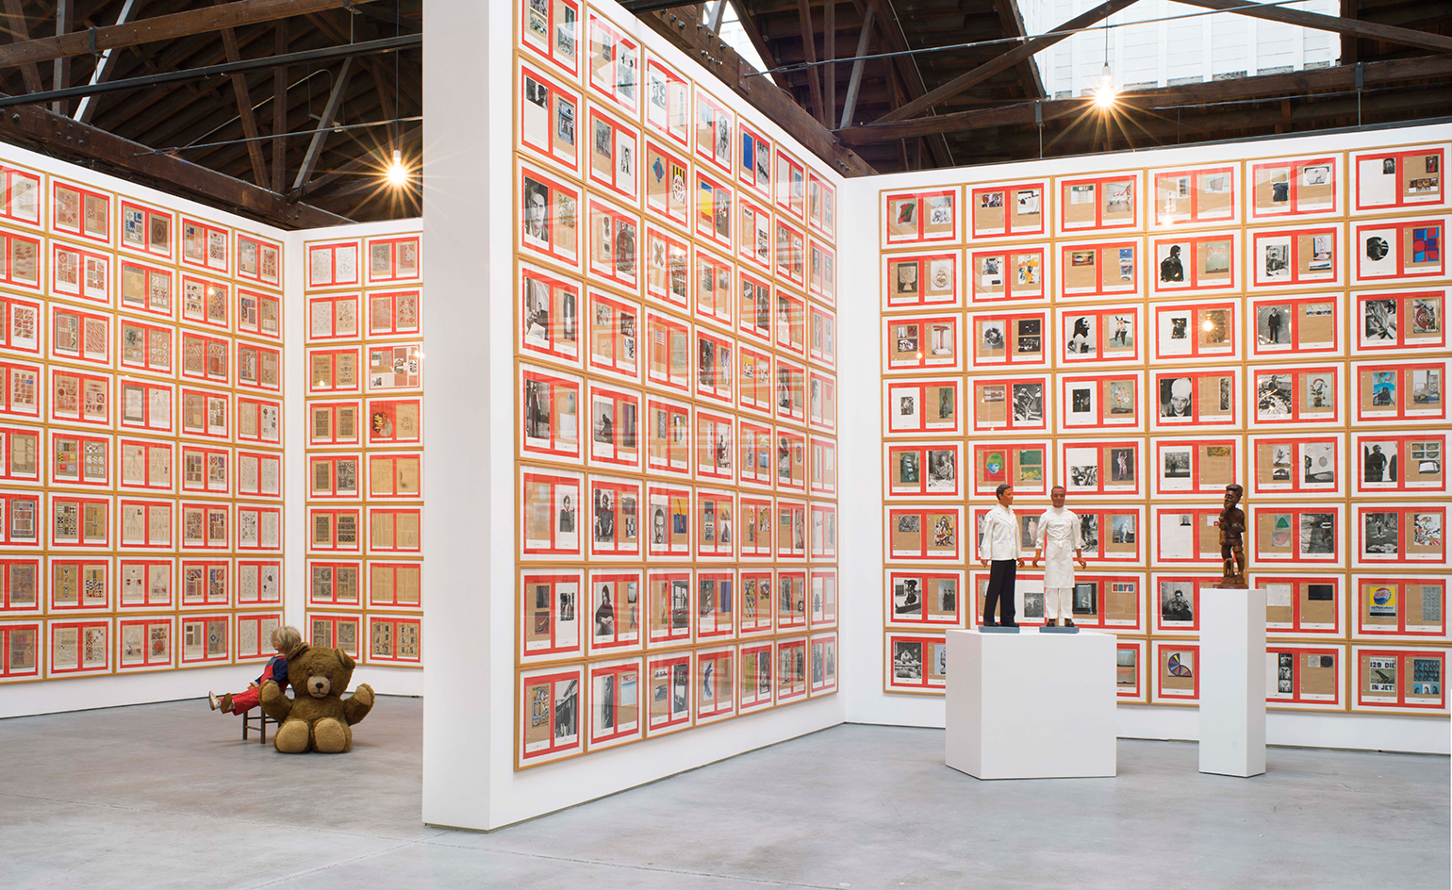
HANNE DARBOVEN

Slide 12
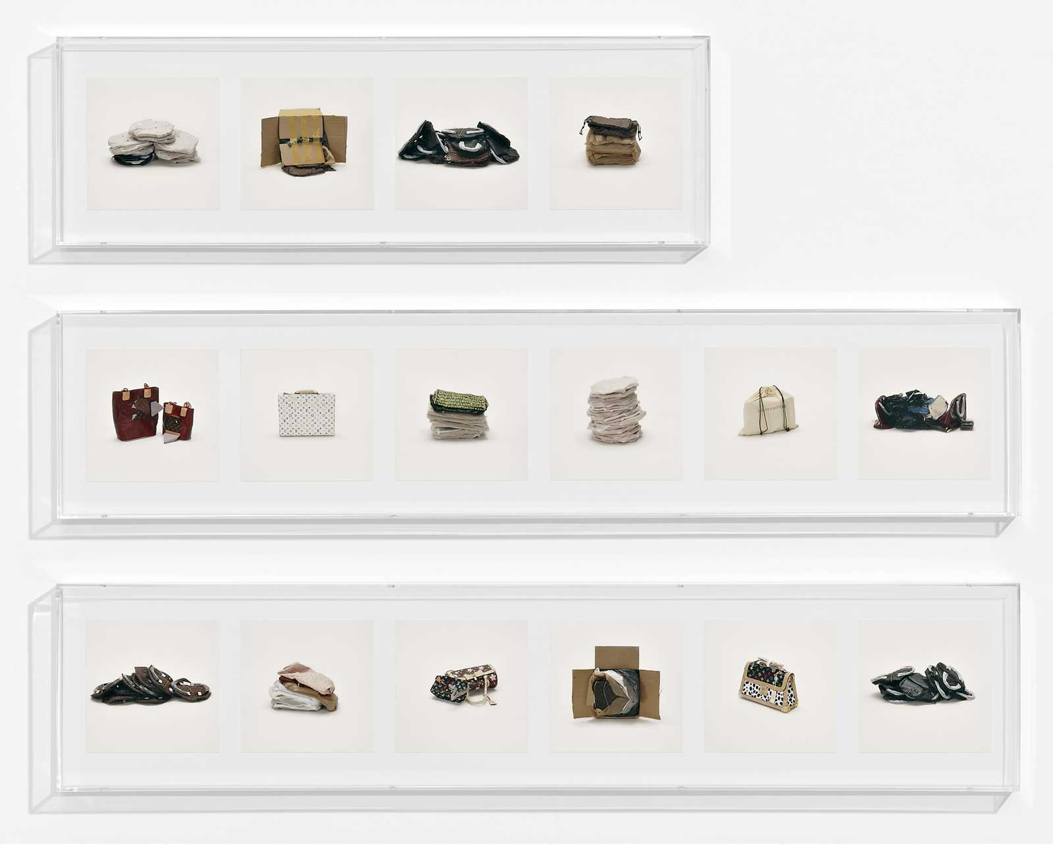
TARYN SIMON

Slide 13
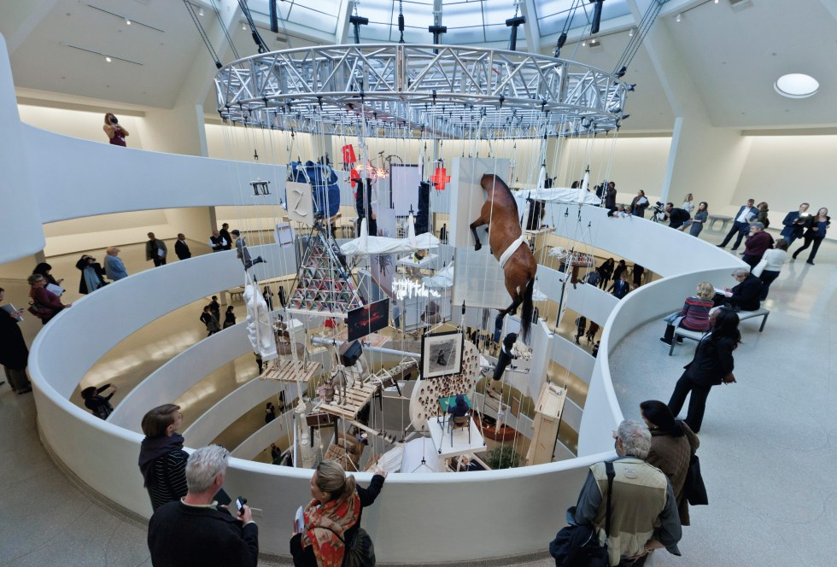
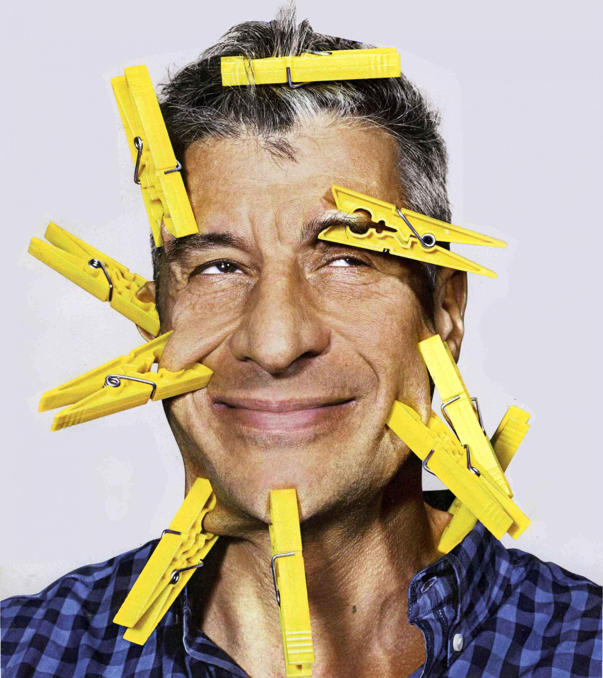
MAURIZIO CATTELAN

Slide 14
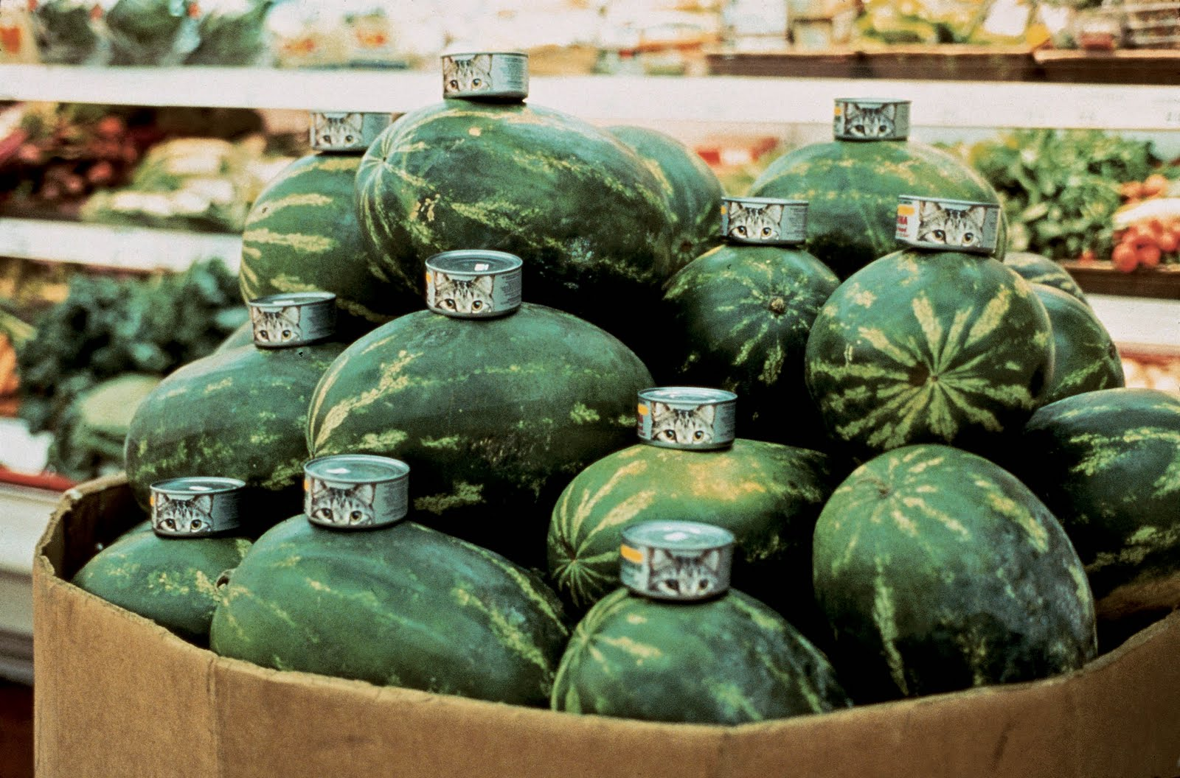
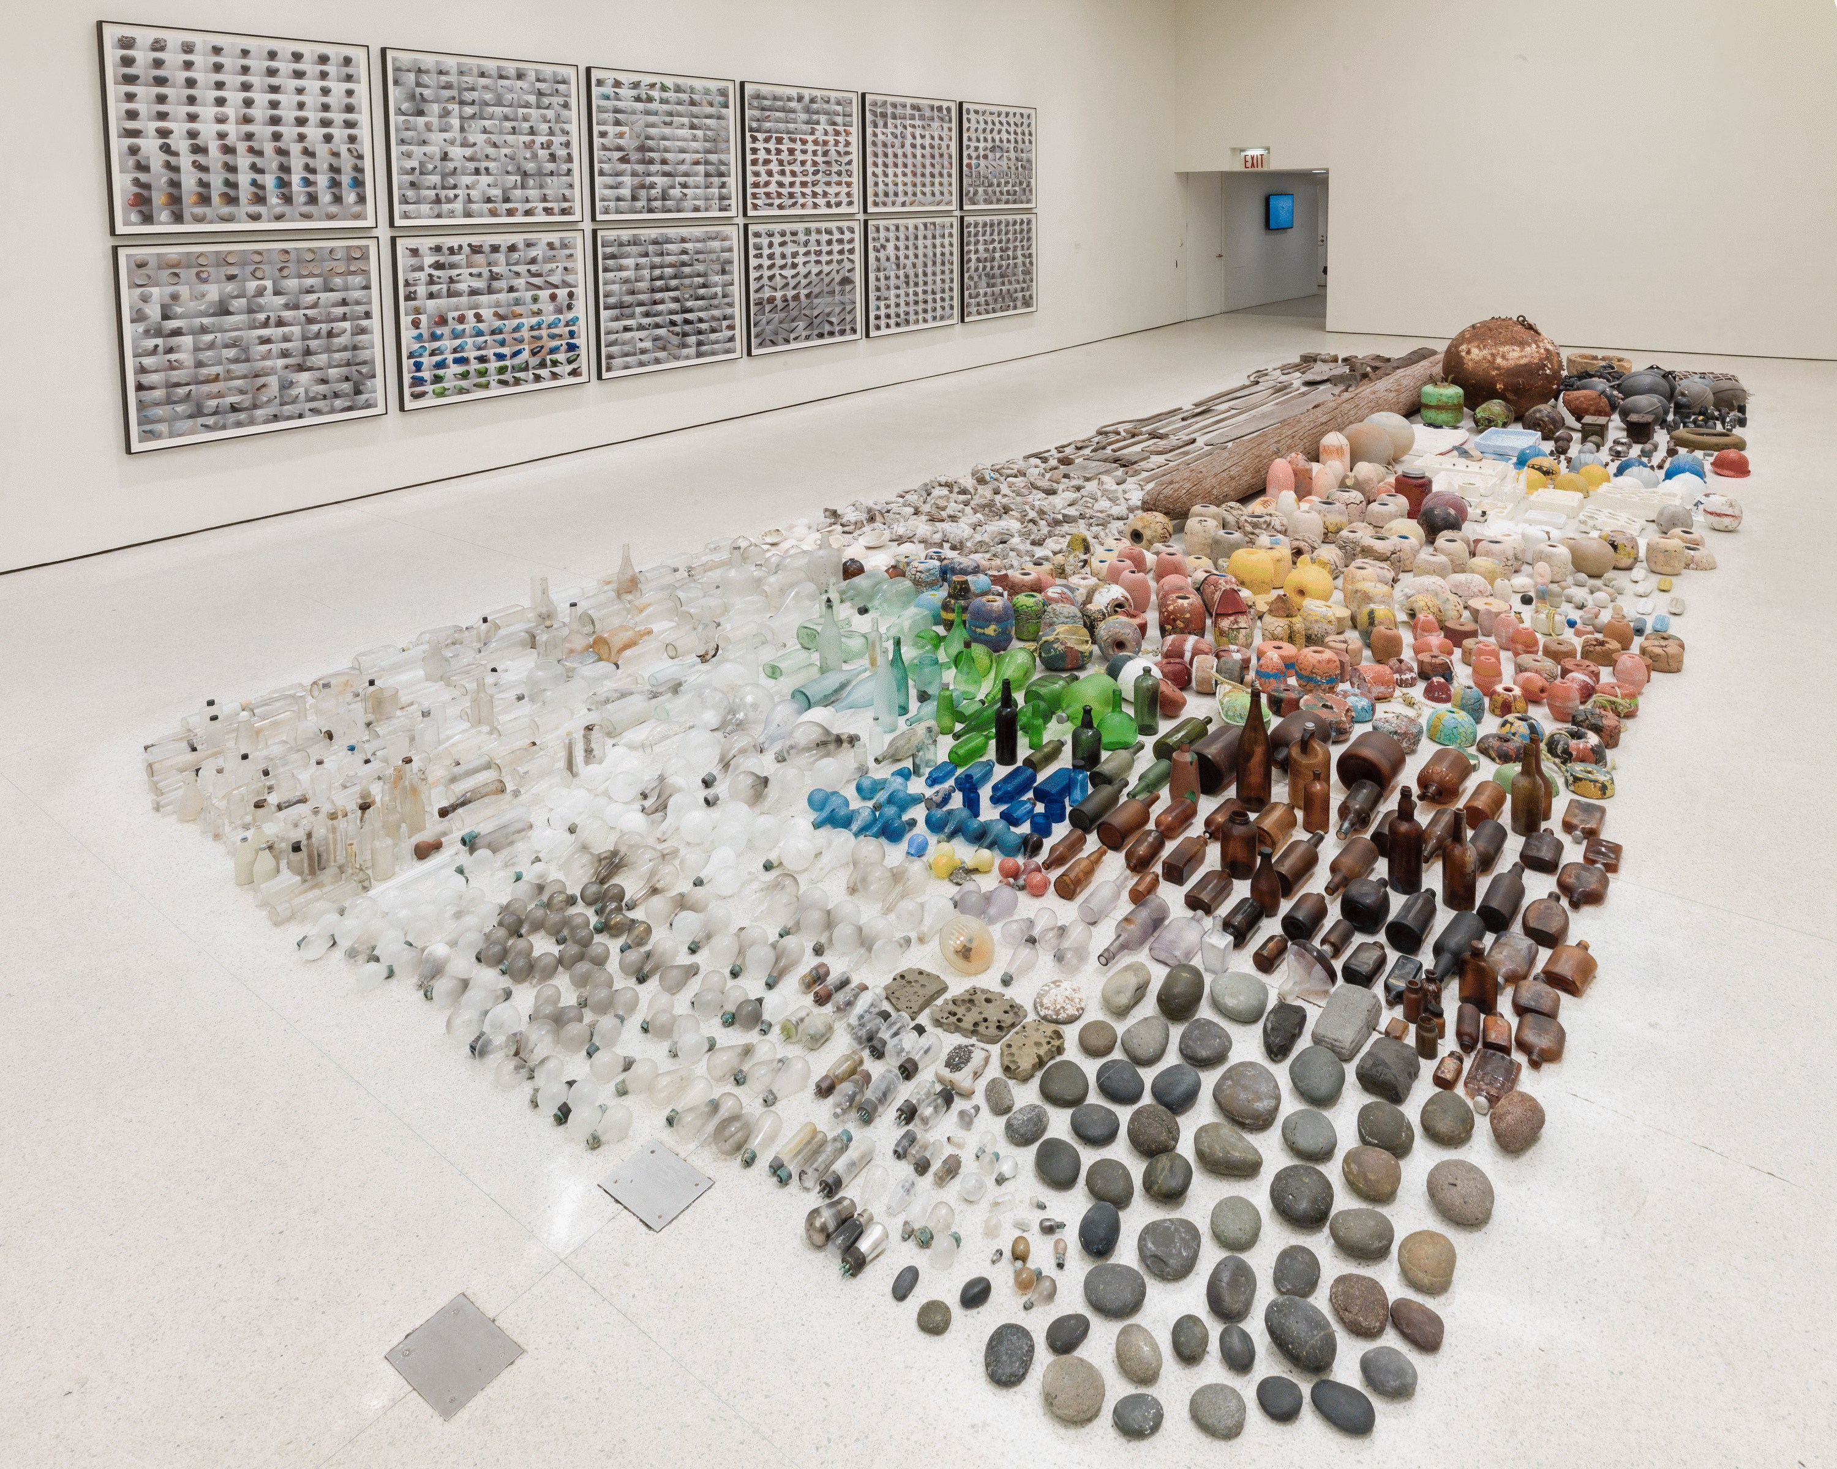
GABRIEL OROZCO

Slide 15
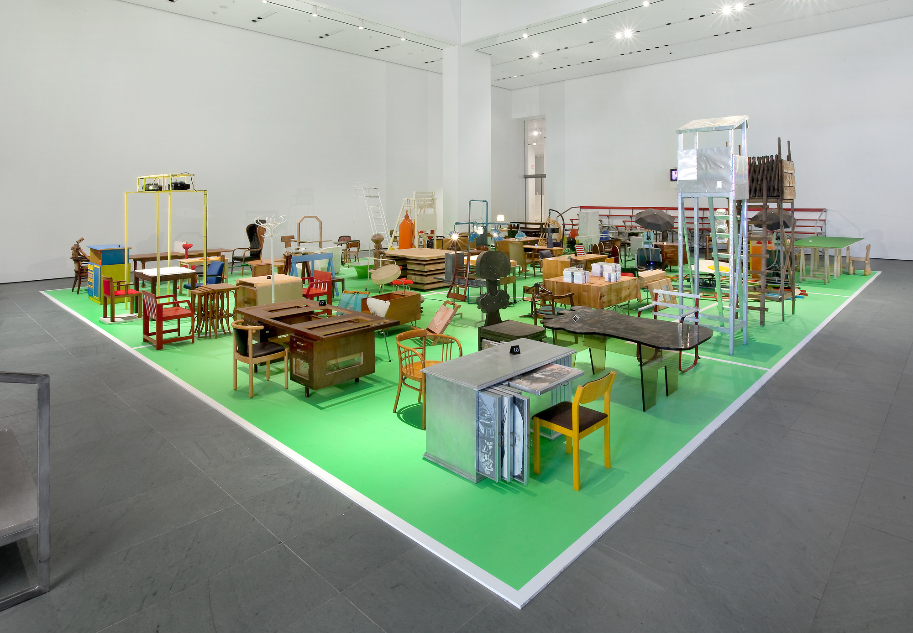
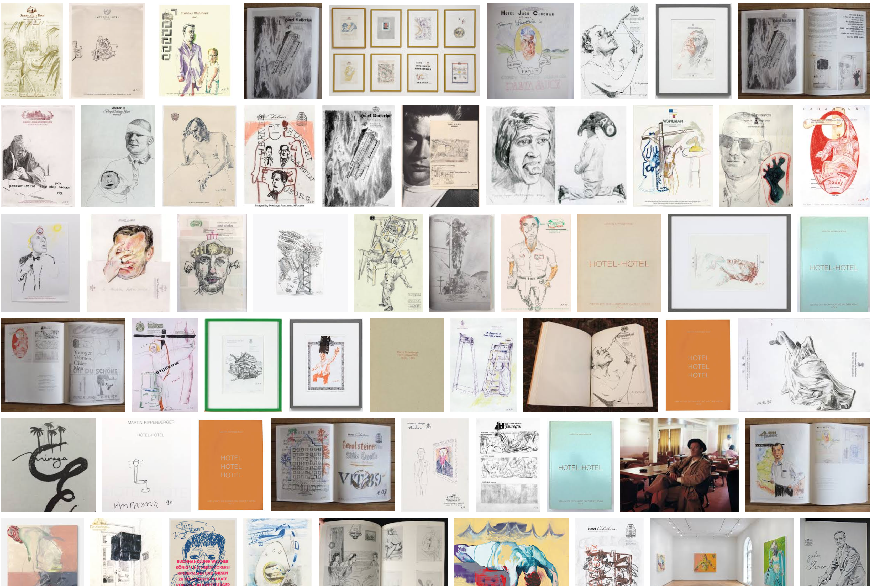
MARTIN KIPPENBERGER

Slide 16
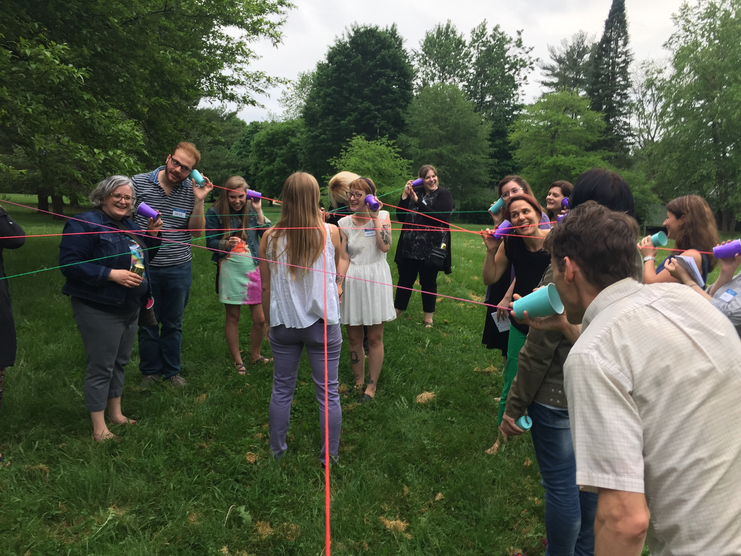
Mode 3:Closeness

Slide 17
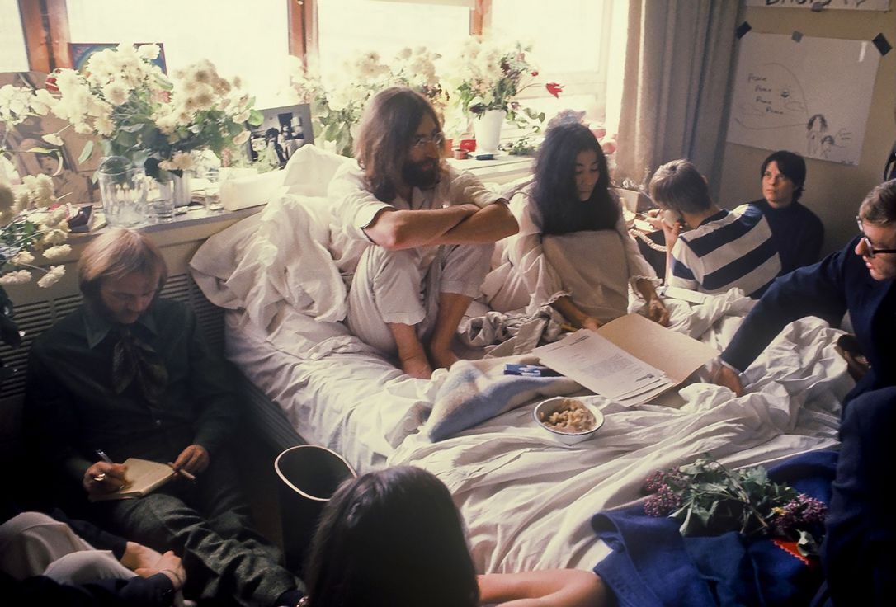
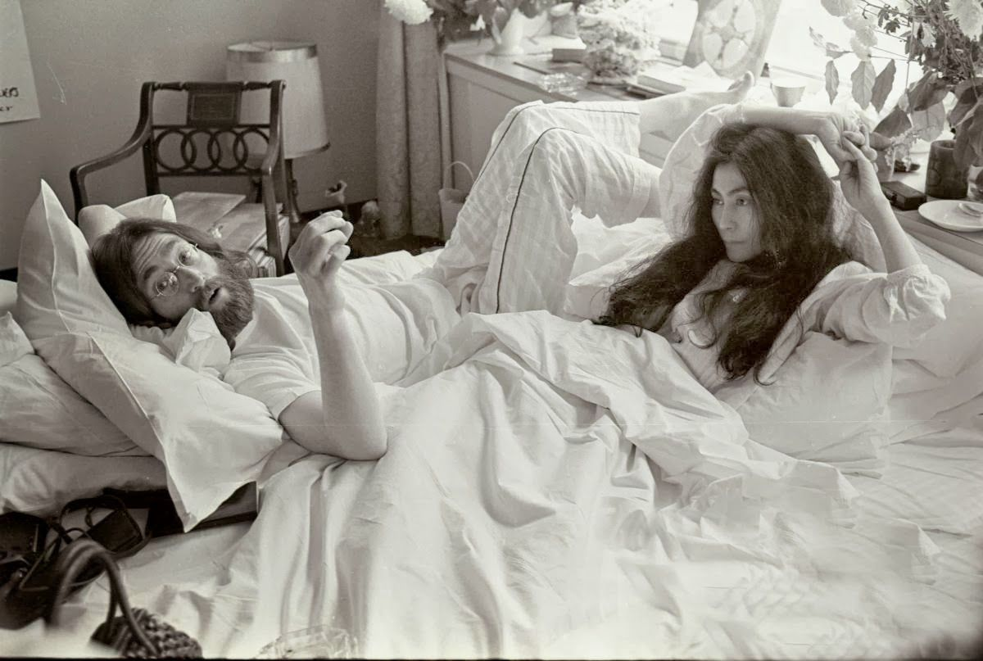
YOKO ONO AND JOHN LENNON

Slide 18
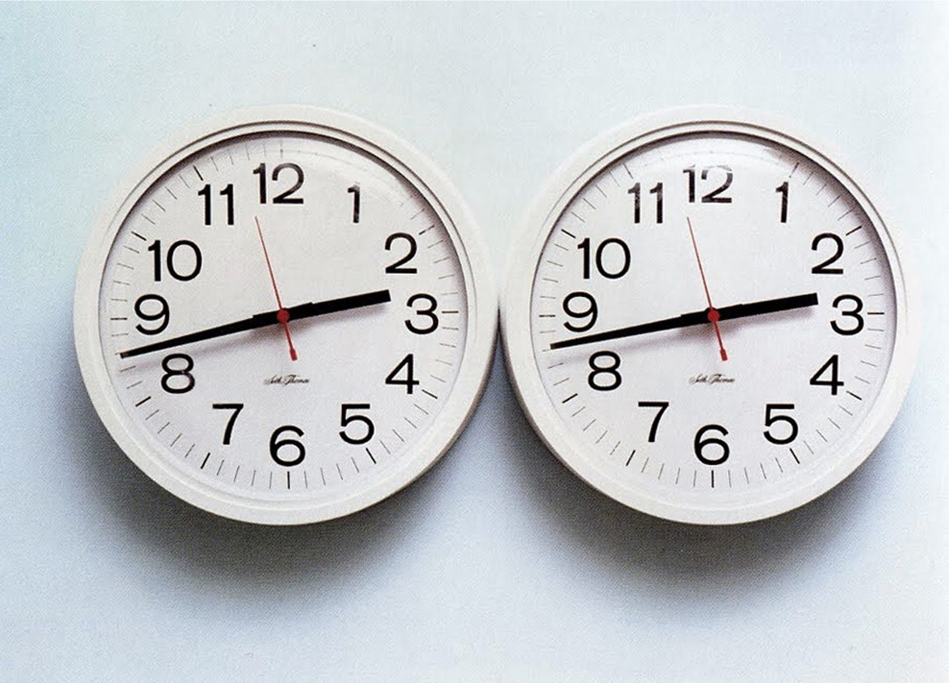
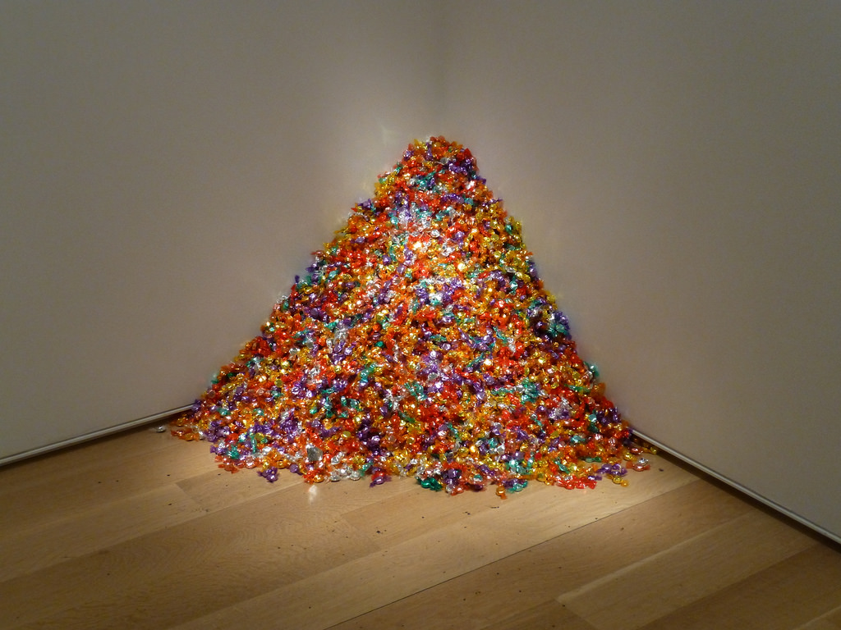
FELIX GONZALEZ TORRES

Slide 19
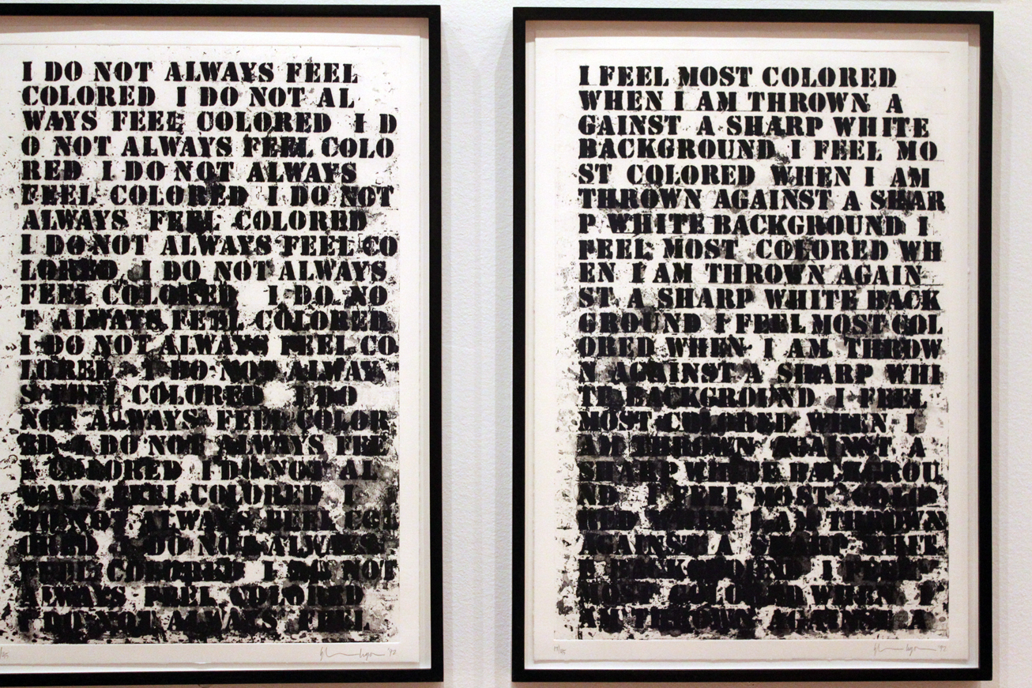
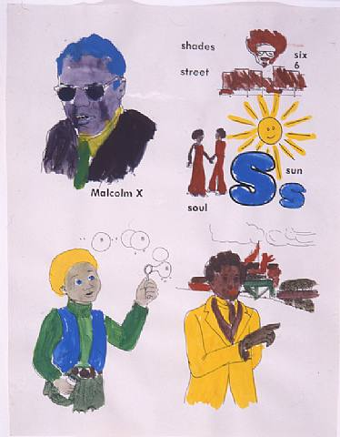
GLENN LIGON

Slide 20
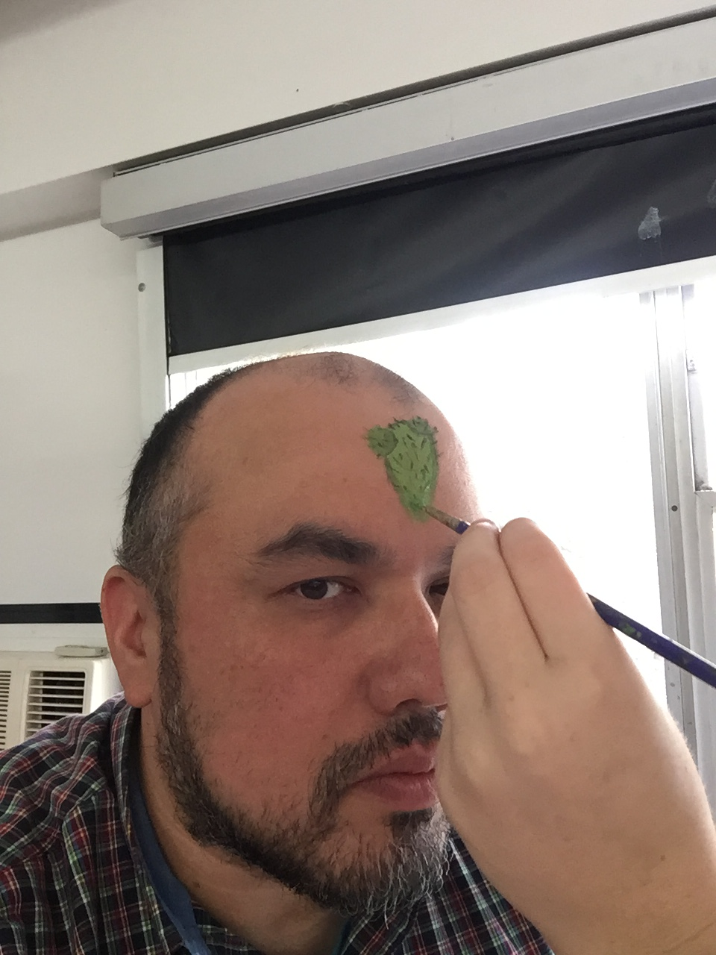
Mode 4: Co-Construct

Slide 21
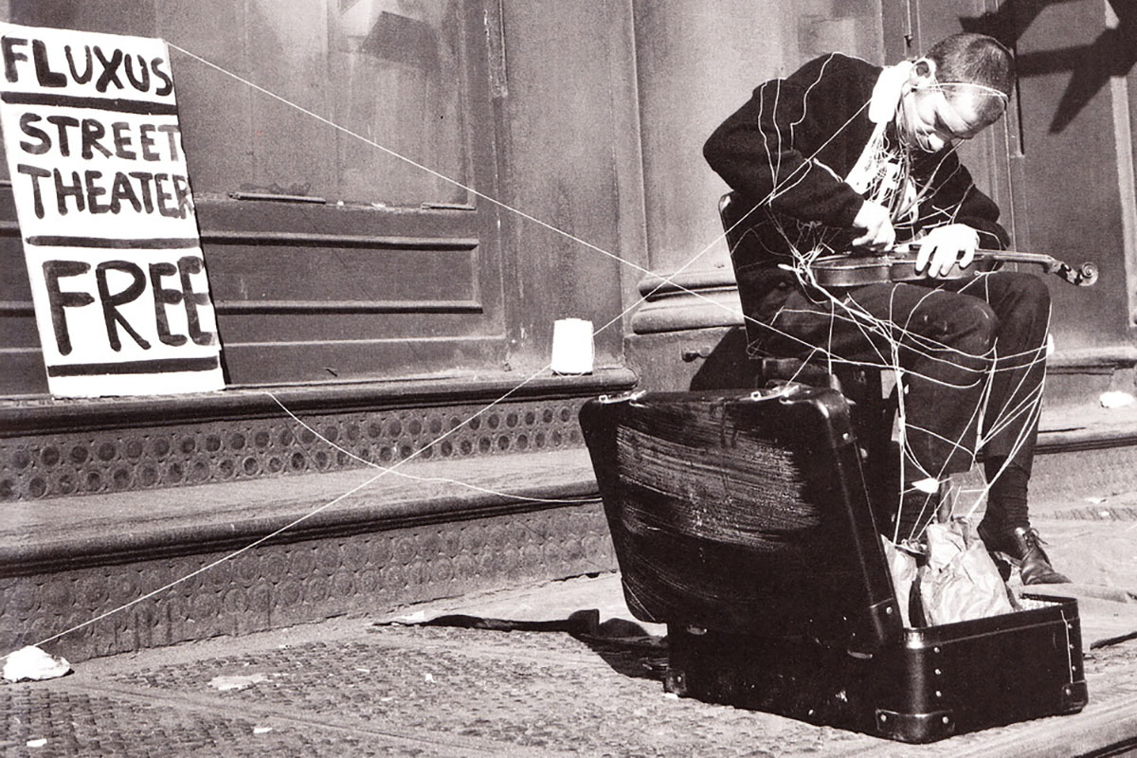
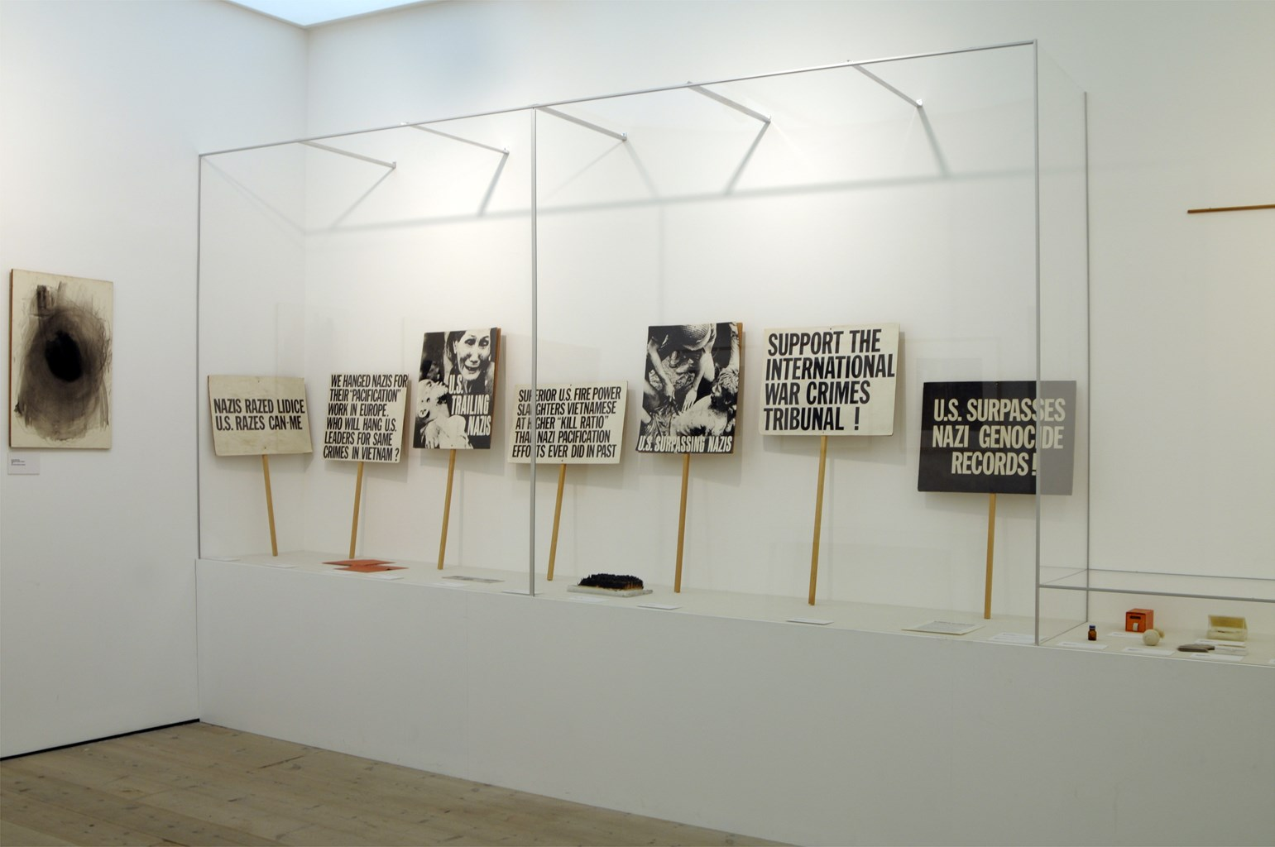
FLUXUS

Slide 22
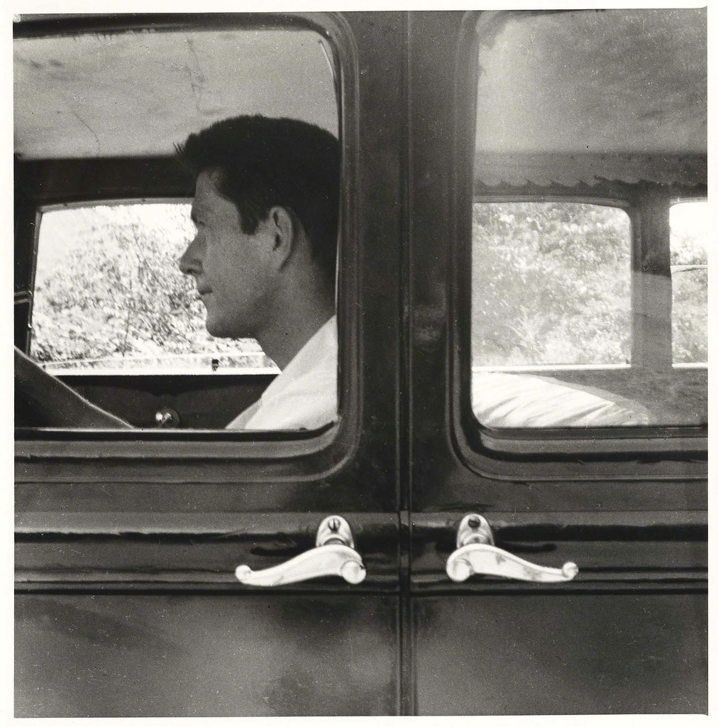
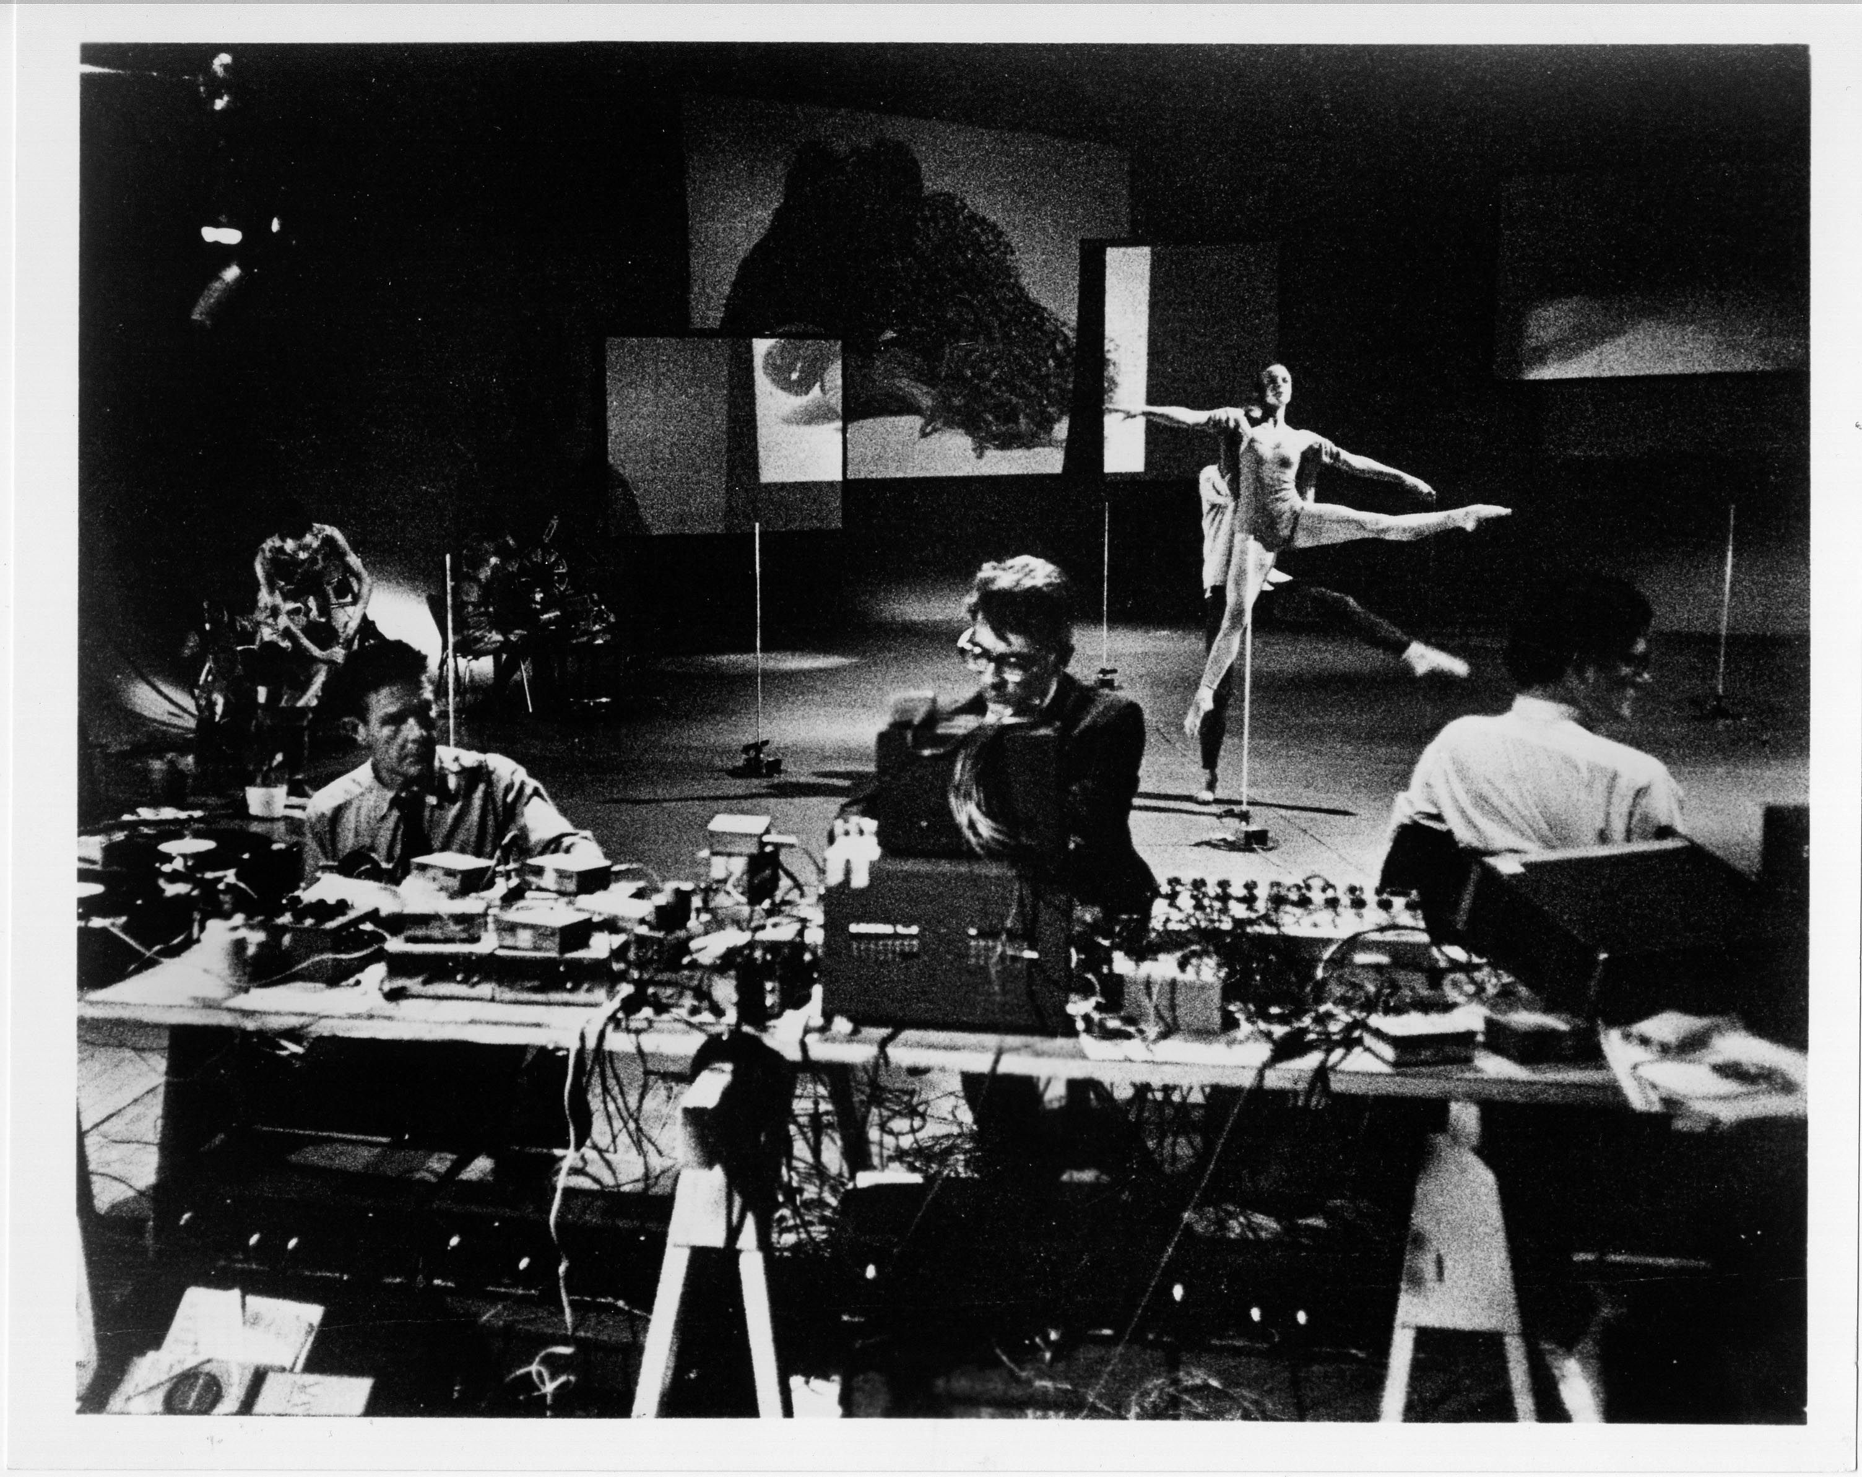
JOHN CAGE

Slide 23
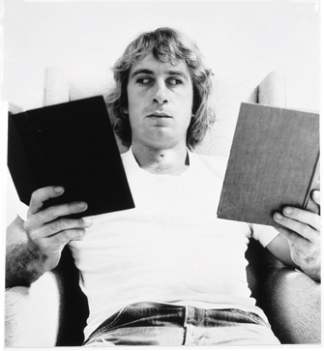
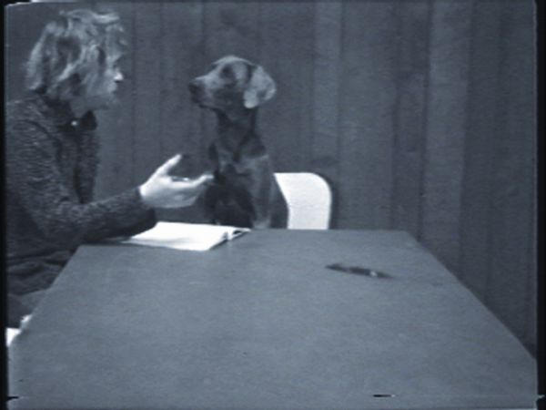
WILLIAM WEGMAN

Slide 24
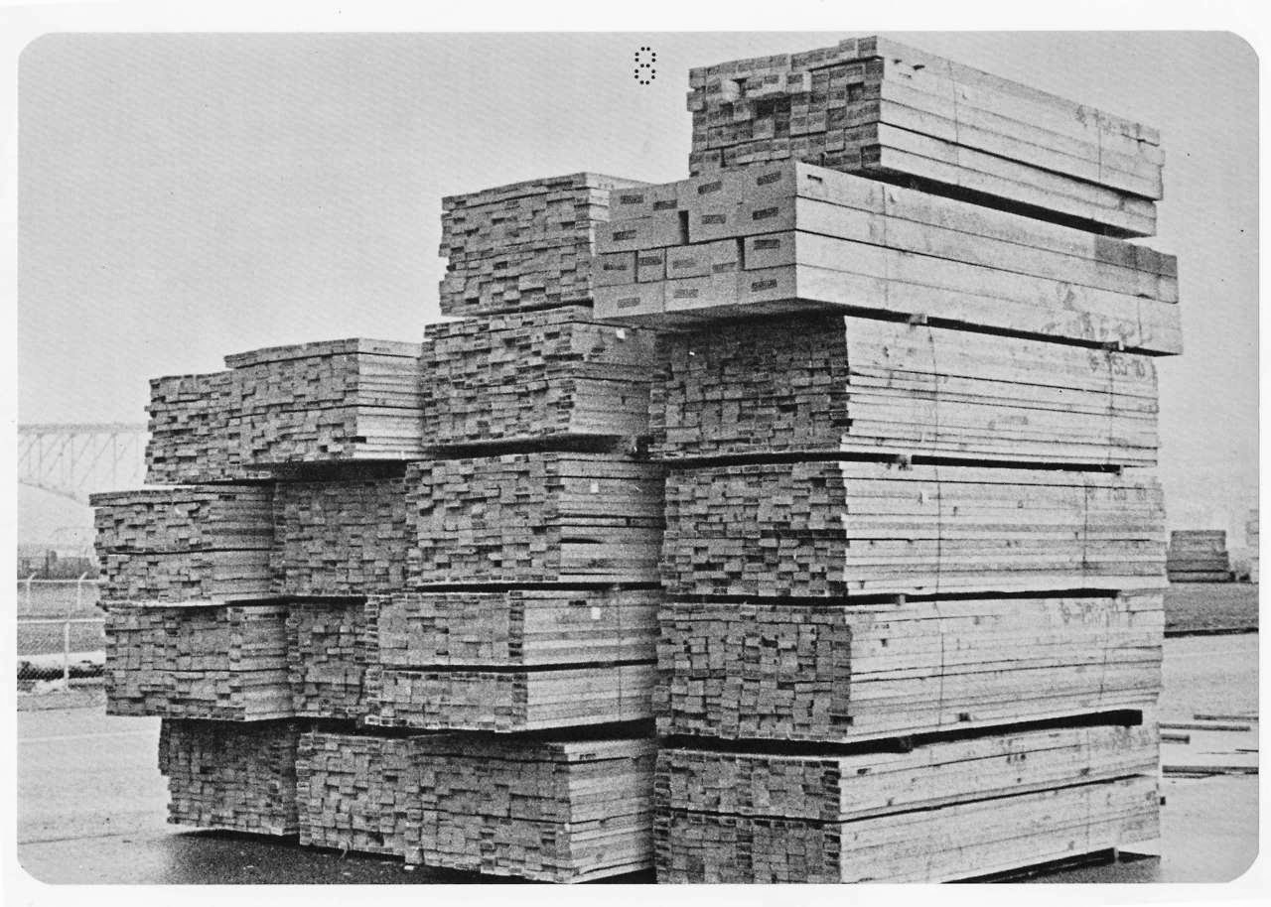
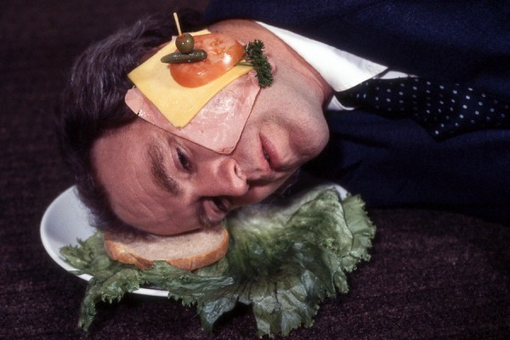
IAIN BAXTER& and N.E. THING

Slide 25
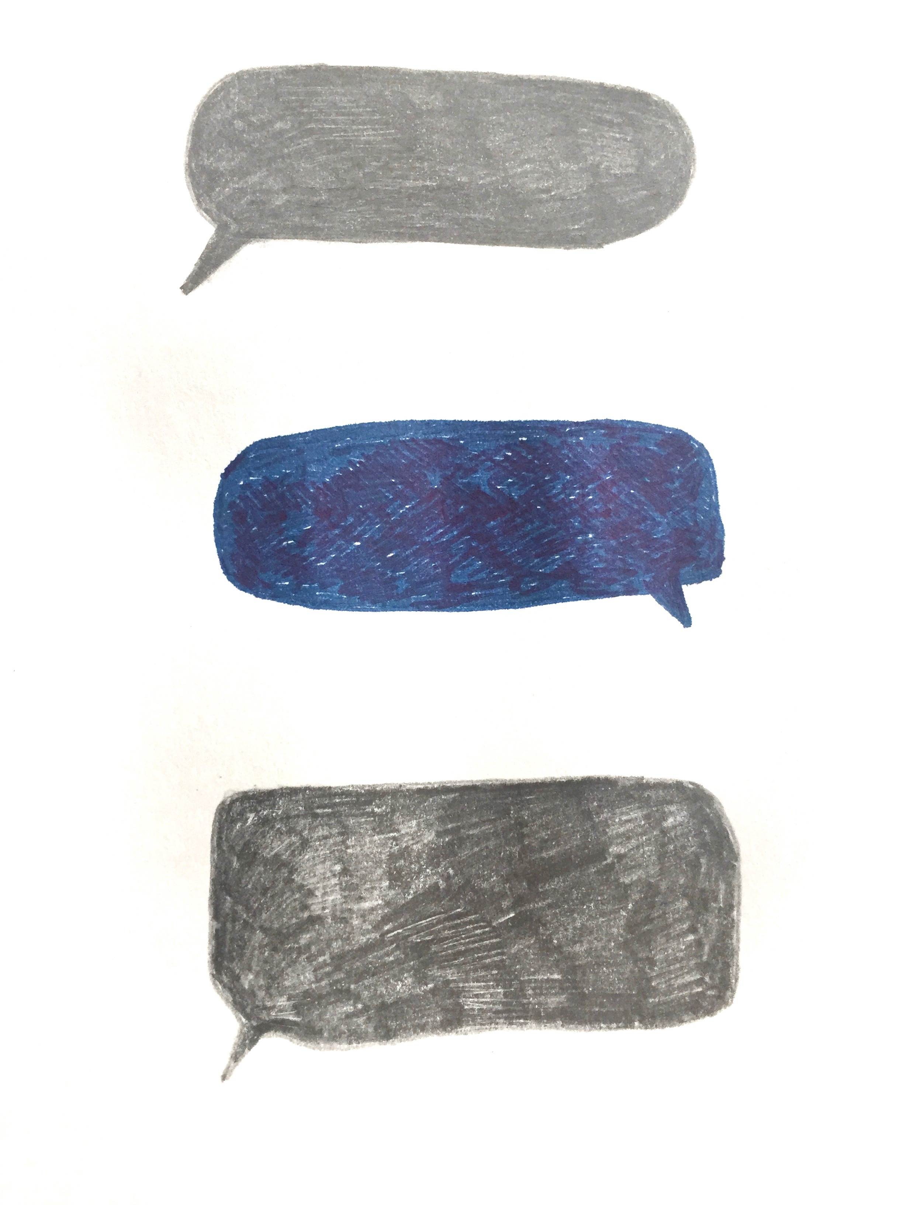
Mode 5: Invisibility

Slide 26
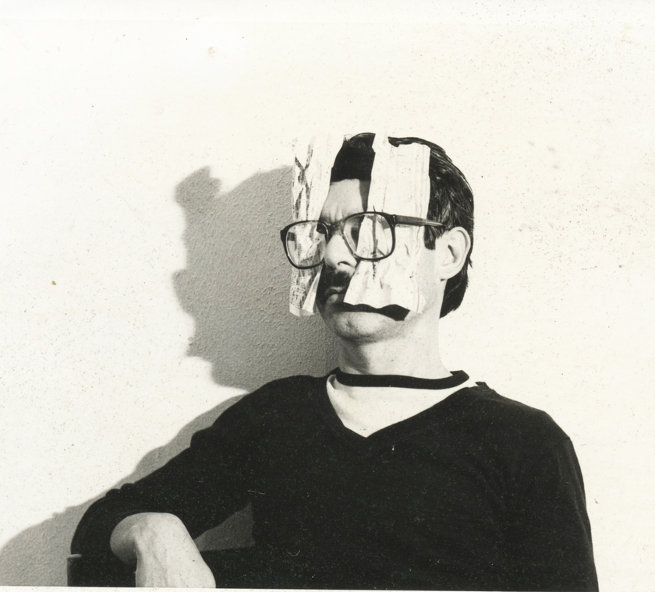
ULISES CARRION and OTHER BOOKS AND SO

Slide 27
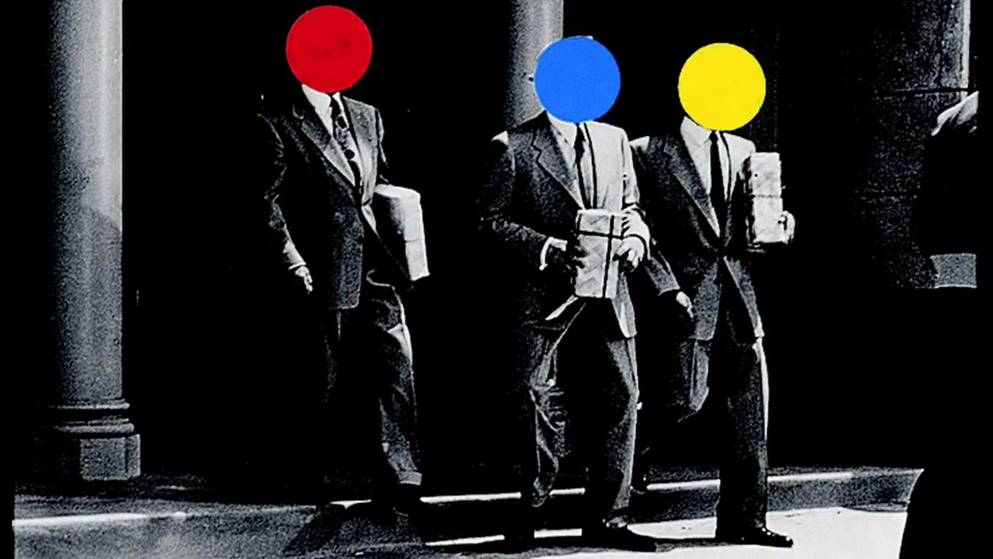
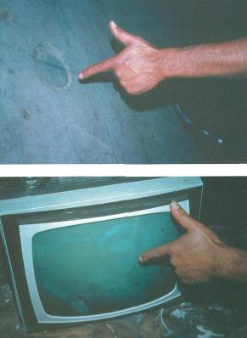
JOHN BALDESSARI

Slide 28
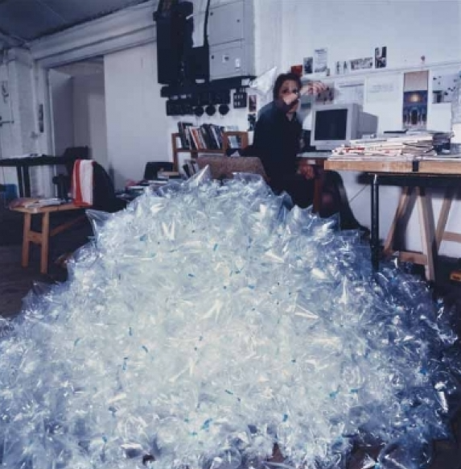
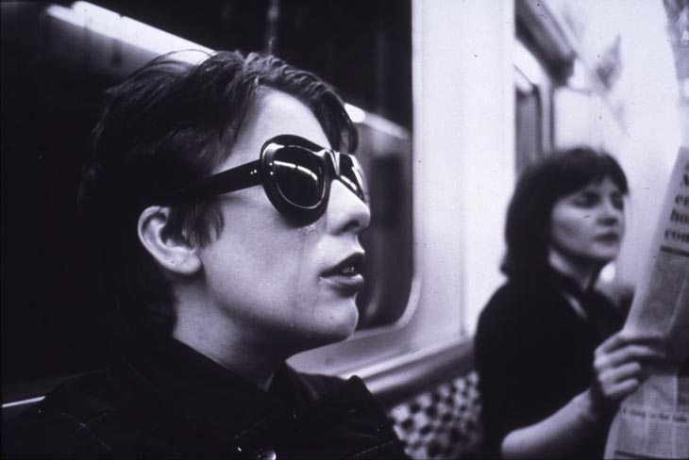
HAYLEY NEWMAN

Slide 29
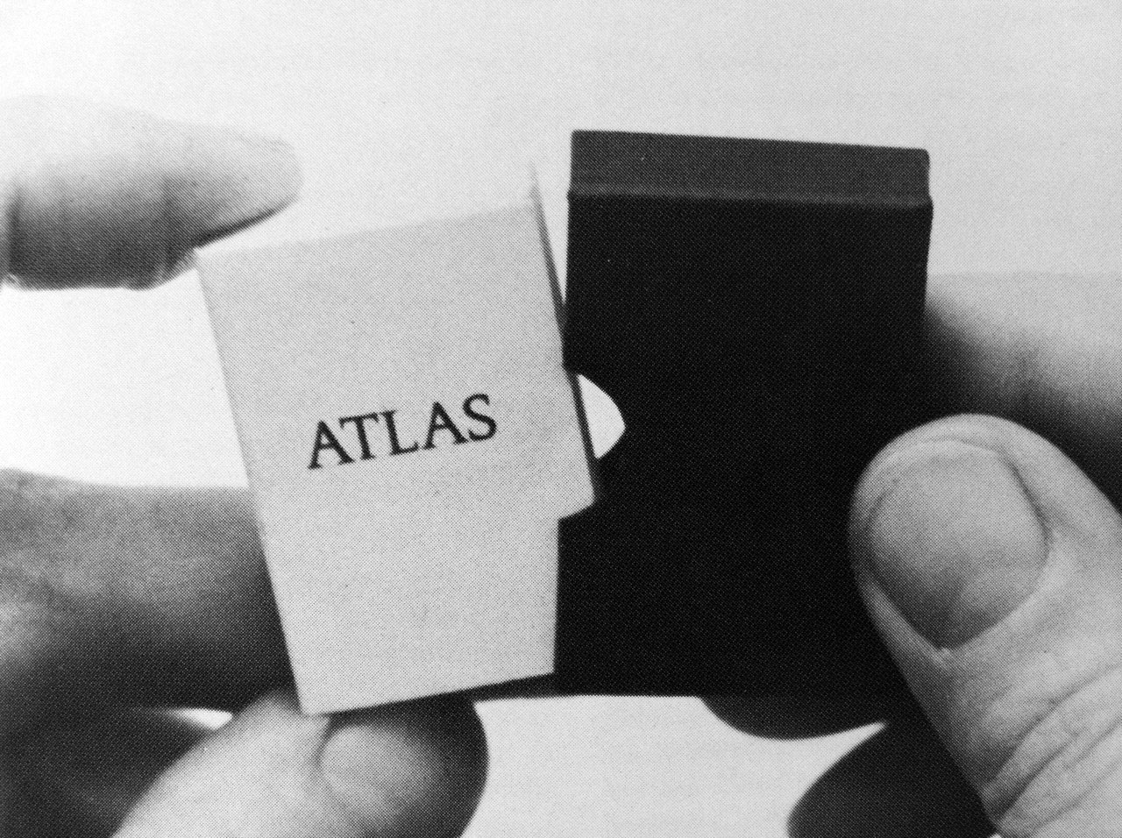
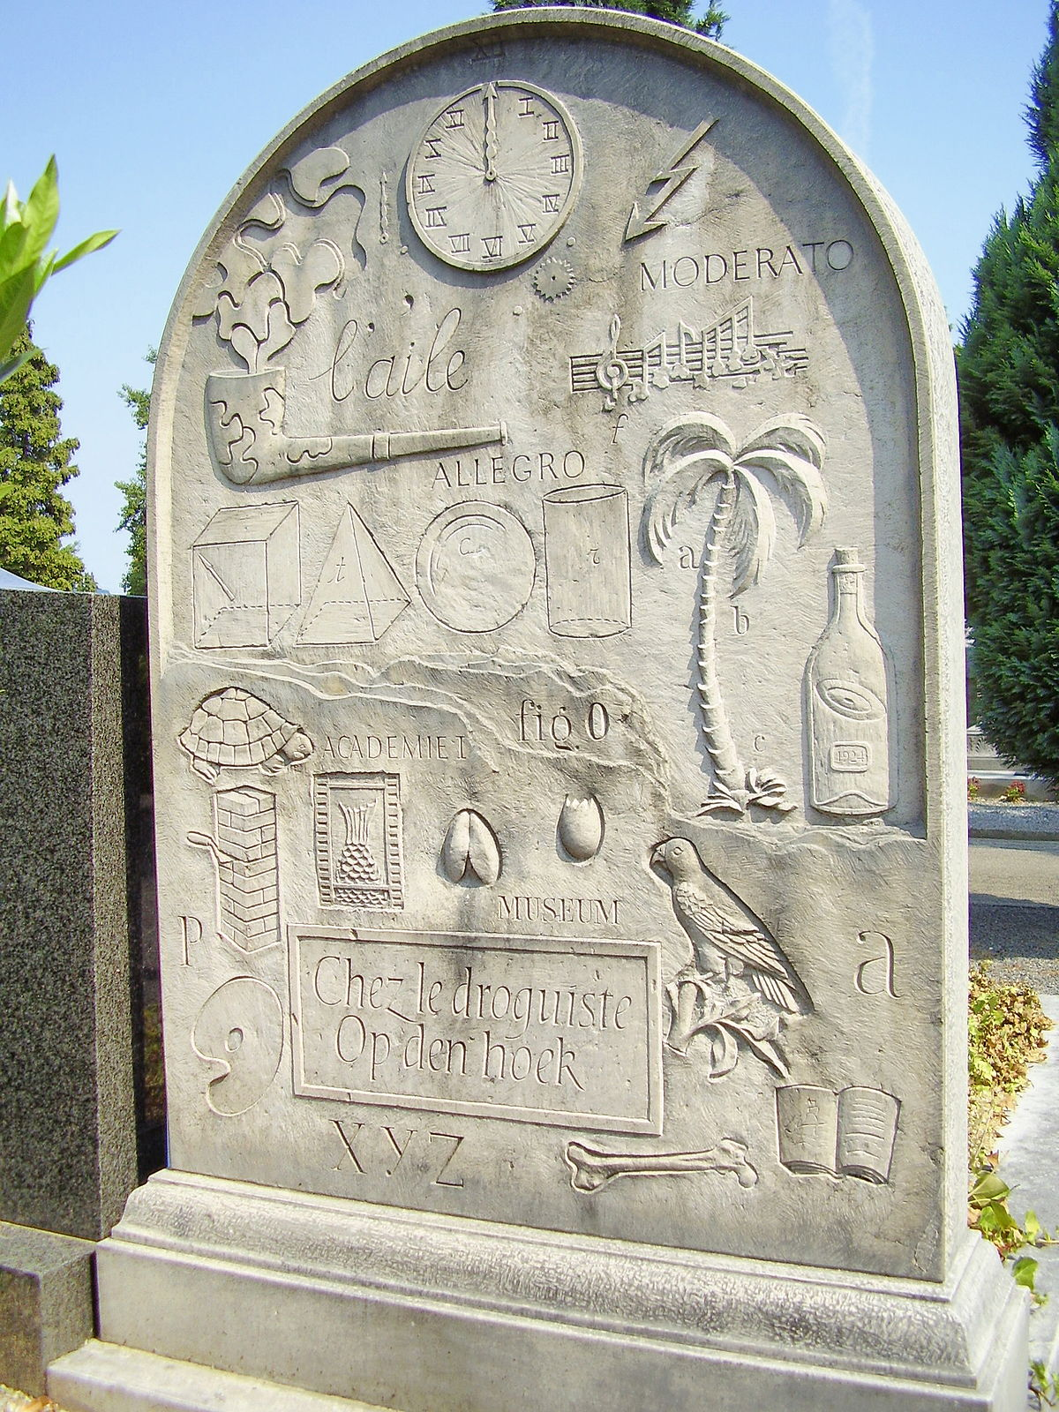
MARCEL BROODTHAERS

Slide 30
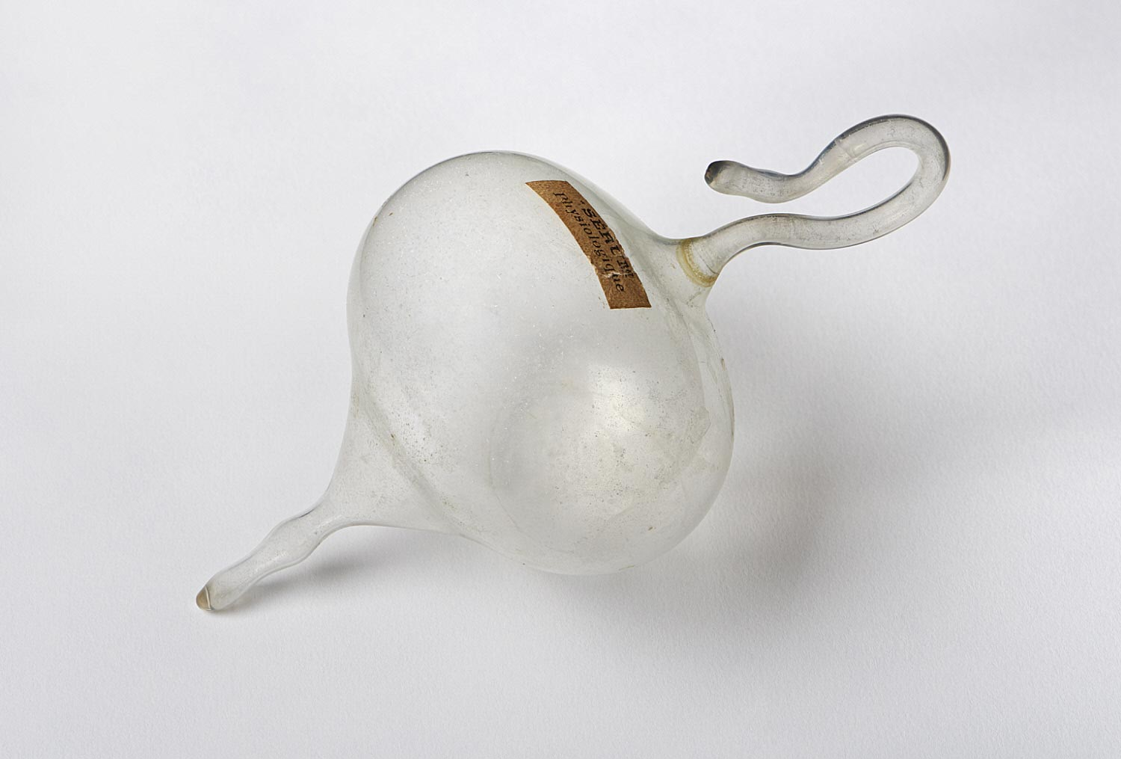
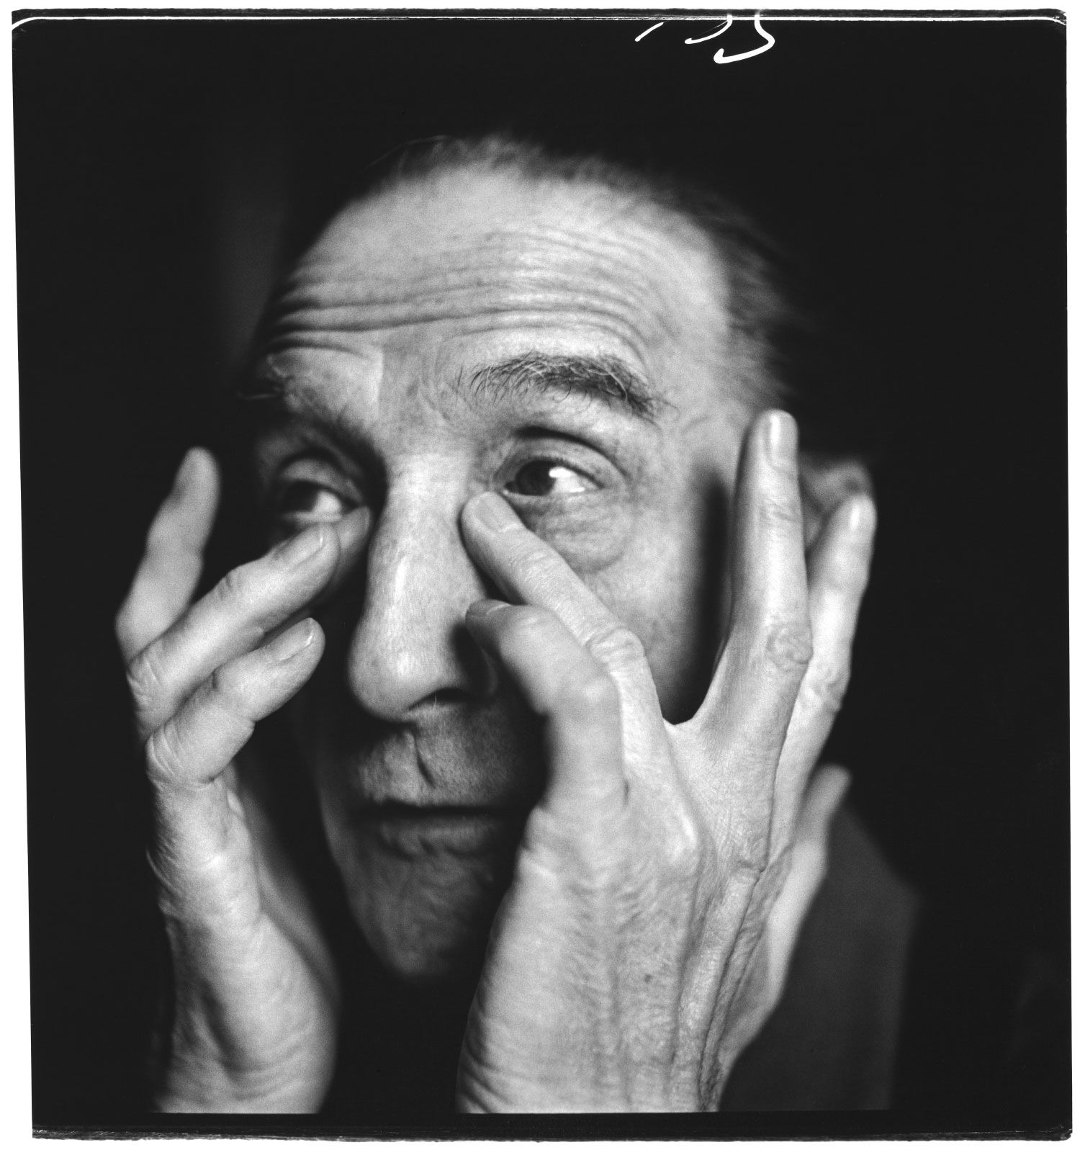
R. MUTT

Slide 31
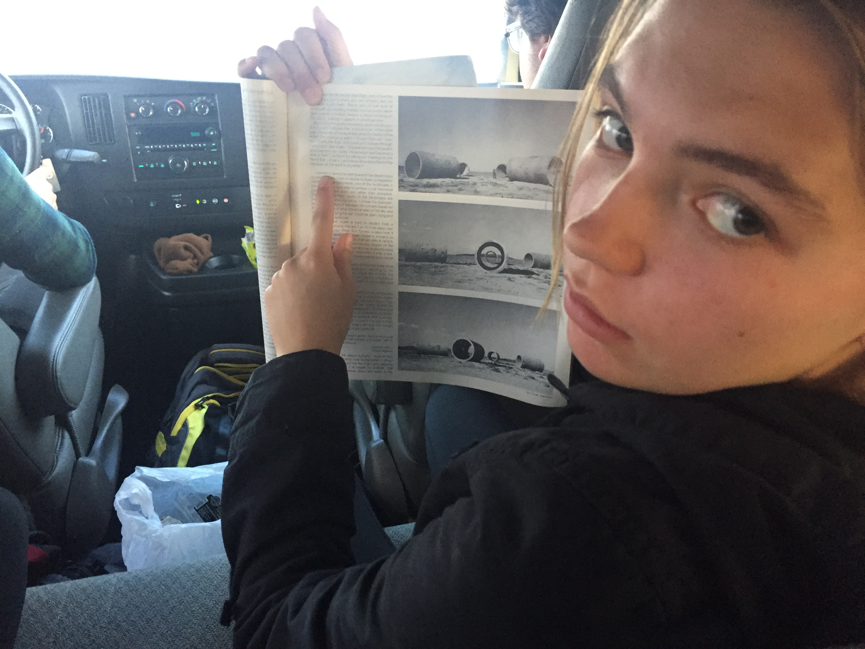
Mode 6: Present Narratives (tell your story)

Slide 32
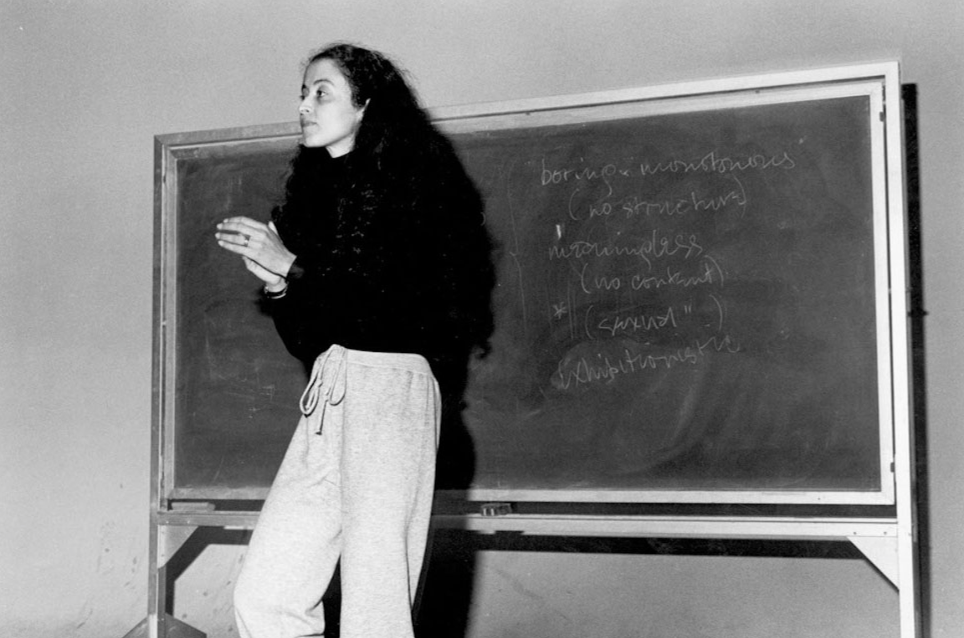
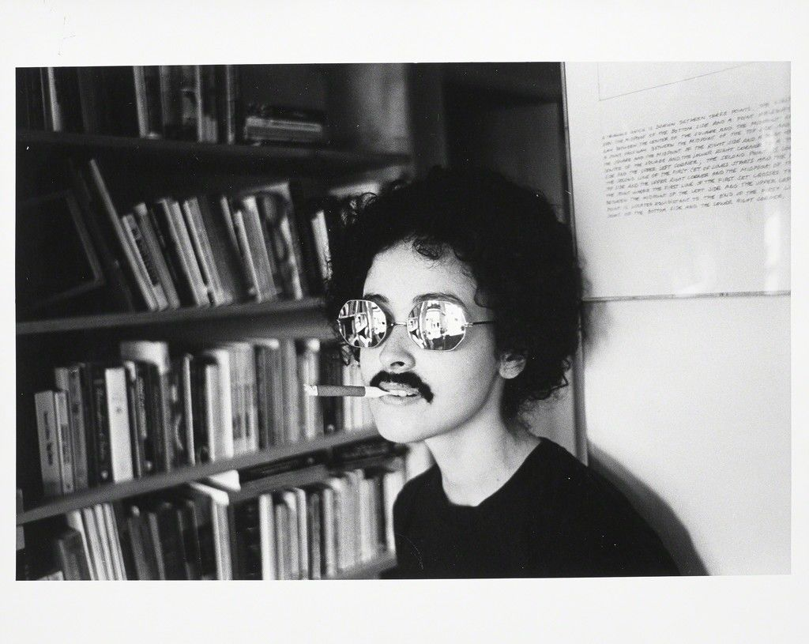
ADRIAN PIPER

Slide 33
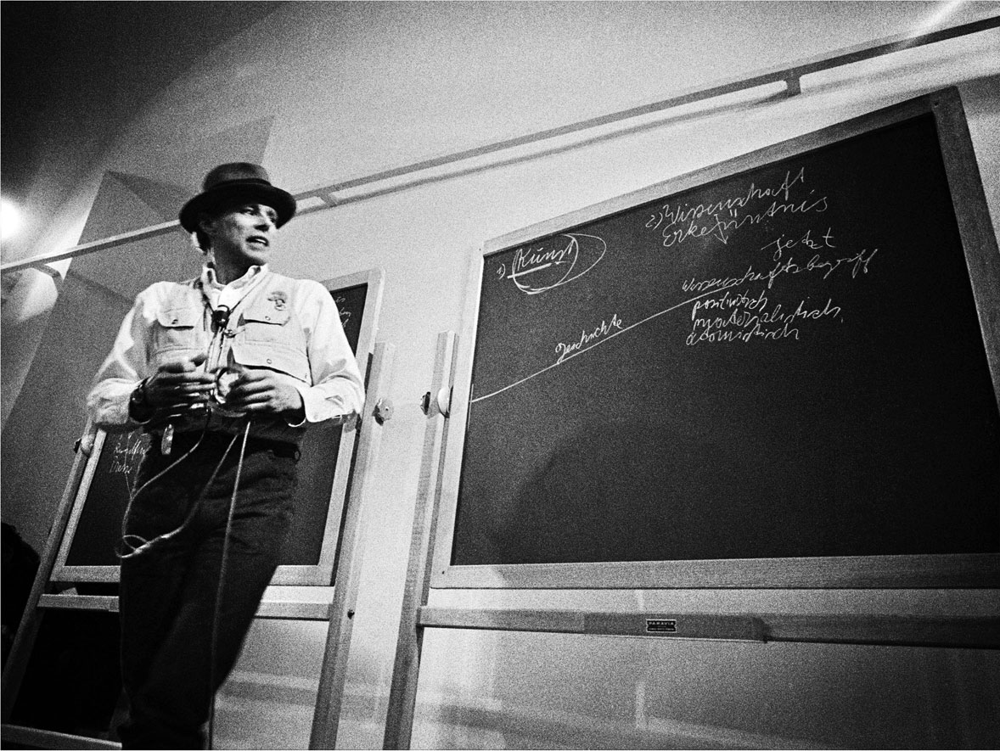
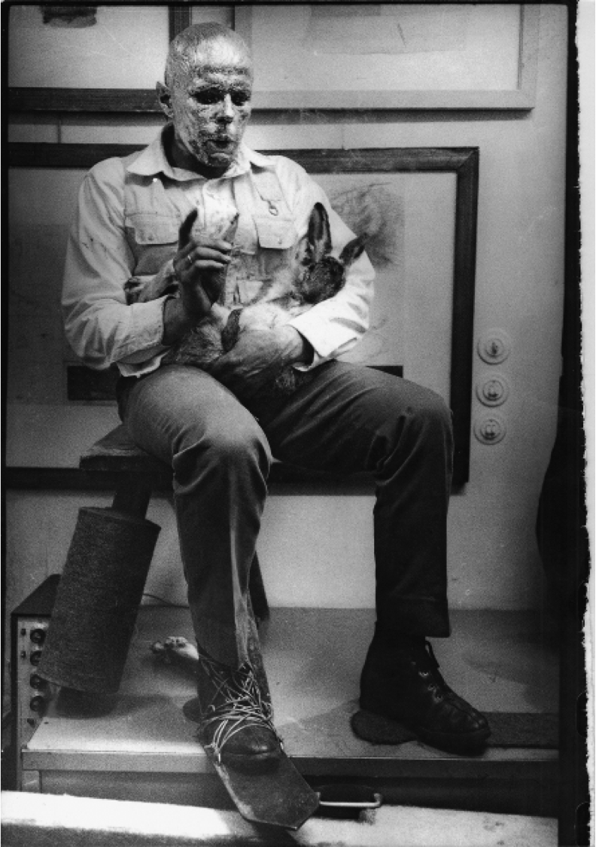
JOSEPH BEUYS

Slide 34
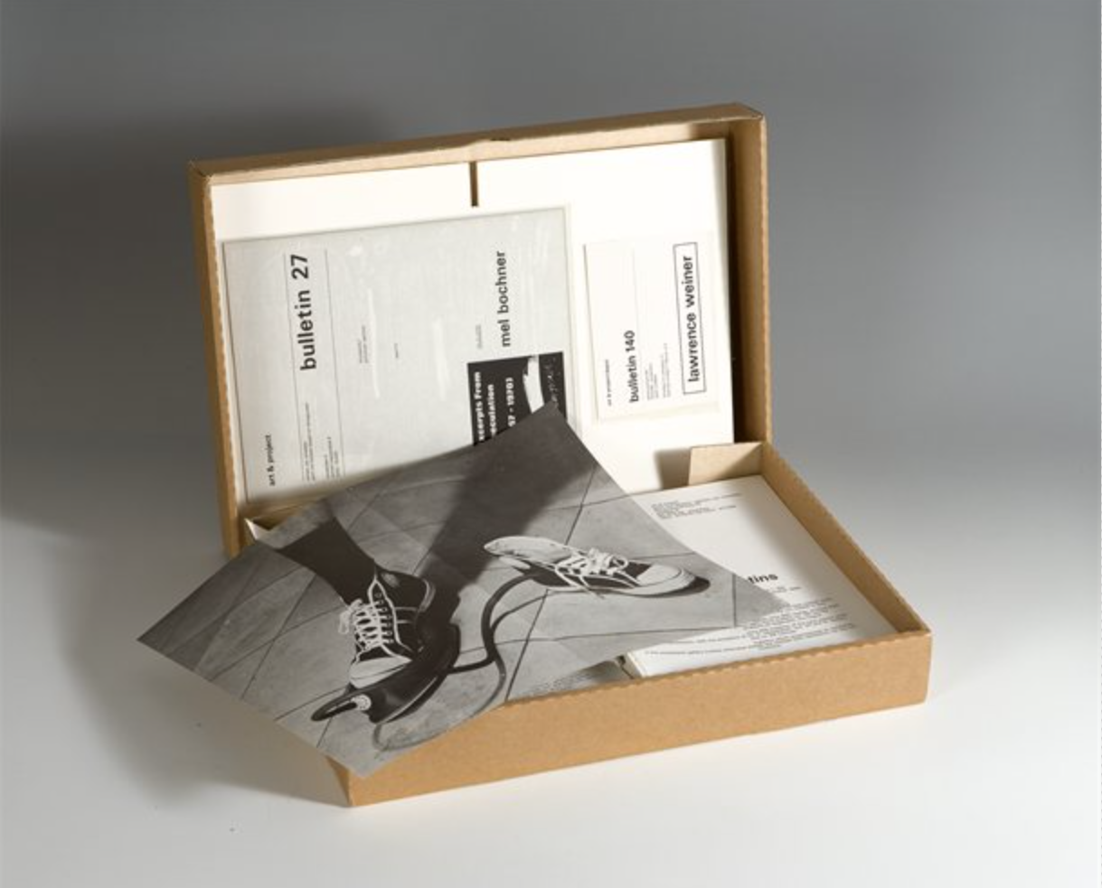
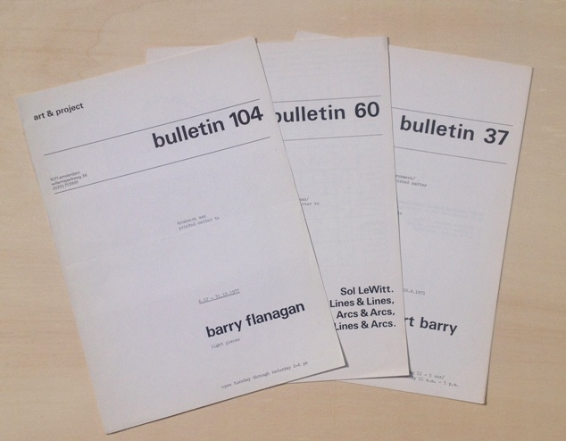
ART & PROJECT

Slide 35
Reflections on the Amsterdam TEACHER AS CONCEPTUAL ARTIST partnership.

Slide 37
